Slide 1

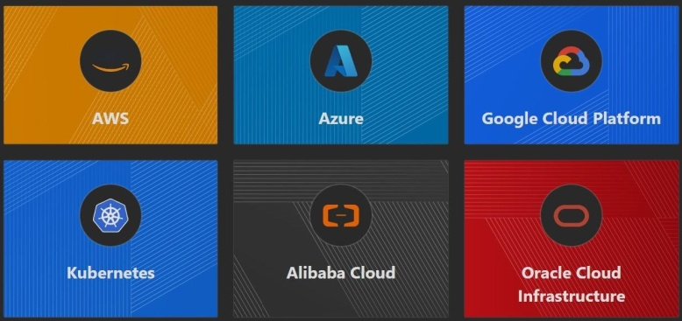
Amazing Terraform
One of the great benefits of Terraform is that it supports thousands of providers.
Once you learn Terraform Core concepts, you can write code to create and manage infrastructure across all the providers.
Terraform

Slide 2

Overview of Terraform Certification
Terraform has become of the most popular and widely used tools to create and manage infrastructure and one of the defacto IAC tools for DevOps.
HashiCorp has released the official Terraform certification to certify students related to core Terraform concepts and skills.

Slide 3
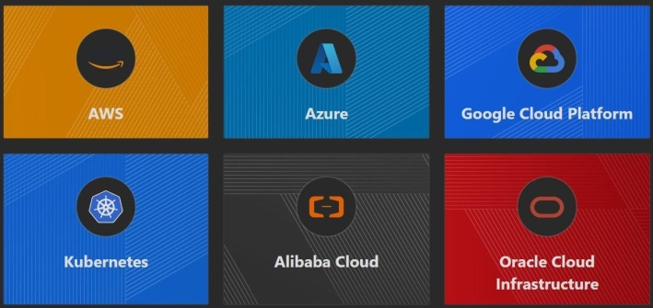
Important Note - Platform for This Course
Terraform supports hundreds of of platforms like AWS, Azure, GCP etc.
To learn Terraform concepts, we have to choose 1 platform for our testing. For this course we have chosen AWS.

Slide 4
Clarification Regarding AWS Platform
Aim of this course is to learn Core Concepts of Terraform and not AWS.
We use very basic AWS services like Virtual Machine, AWS users to demonstrate and Learn the Core Terraform concepts.
The Terraform structure and concepts remain SAME irrespective of platform.
We have hundreds of users from different platform like Azure who have completed this course and are actively implementing Terraform for different platforms..

Slide 5
Infrastructure as Code (IAC)

Slide 6
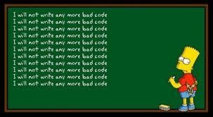
Understanding the Basics
There are two ways in which you can create and manage your infrastructure:
Manually approach.
Through Automation

Slide 7



Work Requirement: Database Backup
I was assigned a task to take database backup every day at 10 PM and the backup had to be stored in Amazon S3 Storage with appropriate timestamp.
db-backup-01-01-2024.sql
db-backup-02-01-2024.sql
Initially due to lack of time, I used to manually take DB backup at 10 PM and upload it to S3.
Initiate Backup
Upload Backup
Amazon S3
Database

Slide 8
Learning from this Work Requirement
If a particular task has to be done in an repeatable manner, it MUST be automated.
Points to Note:
Depending on the type of task, the tools for automation will change.
There are wide variety of Tools & Technologies used for Automation like Ansible, CloudFormation, Terraform, Python etc.

Slide 9




Example of a Single Service
Set of resources (Virtual Machine, Database, S3, AWS Users) must be created with exact similar configuration in Dev, Stage and Production environment.
Development ENV
Staging ENV
Production ENV

Slide 10

Example of a Single Service - Automated Way
IAC Tool
Development ENV
Staging ENV
Production ENV

Slide 11
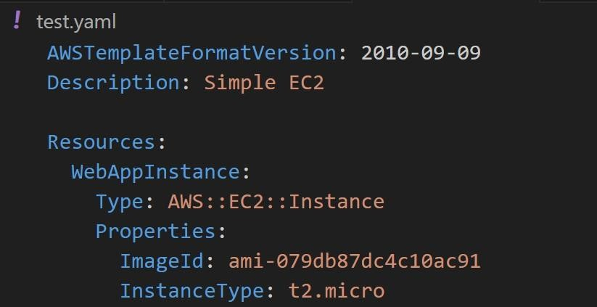
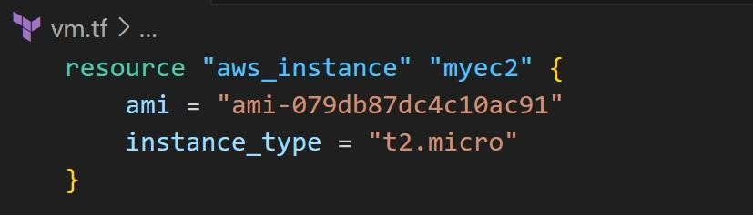
Basics of Infrastructure as Code
Infrastructure as Code (IaC) is the managing and provisioning of infrastructure through code instead of through manual processes.

Slide 12
Benefits of Infrastructure As Code
There are several benefits of designing your infrastructure as code:
Speed of Infrastructure Management.
Low Risk of Human Errors.
Version Control.
Easy collaboration between Teams.

Slide 13
Choosing Right IAC Tool

Slide 14
Available Tools
There are various types of tools that can allow you to deploy infrastructure as code :
Terraform
CloudFormation
Heat
Ansible
SaltStack
Chef, Puppet and others

Slide 15
Categories of Tools
The tools are widely divided into two major categories
Infrastructure As Code
Infrastructure Orchestration
Configuration Management
Terraform, CloudFormation
Ansible, Chef

Slide 16

Configuration Management
Configuration Management tools are primarily used to maintain desired configuration of systems (inside servers)
Example: ALL servers should have Antivirus installed with version 10.0.2
Installing AV
Ansible
Server Fleet

Slide 17


Infrastructure Orchestration
Infrastructure Orchestration is primarily used to create and manage infrastructure environments.
Example: Create 3 Servers with 4 GB RAM, 2 vCPUs. Each server should have firewall rule to allow SSH connection from Office IPs.
Terraform
Infrastructure Fleet

Slide 18


IAC & Configuration Management = Friends
Deploy Server
Terraform
Completed
first_server.tf
Terraform
EC2 Running
New E2
Install & Configure Application
AWS
Ansible

Slide 19
How to choose IAC Tool?
i) Is your infrastructure going to be vendor specific in longer term ? Example AWS.
ii) Are you planning to have multi-cloud / hybrid cloud based infrastructure ?
iii) How well does it integrate with configuration management tools ?
iv) Price and Support

Slide 20
Use-Case 1 - Requirement of Organization 1
1. Organization is going to be based on AWS for next 25 years.
2. Official support is required in-case if team face any issue related to IAC tool or code itself.
3. They want some kind of GUI interface that supports automatic code generation.

Slide 21
Use-Case 2 - Requirement of Organization 2
1. Organization is based on Hybrid Solution. They use VMware for on-premise setup; AWS, Azure and GCP for Cloud.
2. Official support is required in-case if IAC tool has any issues.

Slide 22
Installing Terraform
Terraform in detail

Slide 23

Overview of Installation Process
Terraform installation is very simple.
You have a single binary file, download and use it.
Download
terraform

Slide 24
Supported Platforms
Terraform works on multiple platforms, these includes:
Windows
macOS
Linux
FreeBSD
OpenBSD
Solaris

Slide 25
Terraform Installation - Mac & Linux
There are two primary steps required to install terraform in Mac and Linux
1) Download the Terraform Binary File.
2) Move it in the right path.

Slide 26
Choosing IDE For Terraform
Terraform in detail

Slide 27
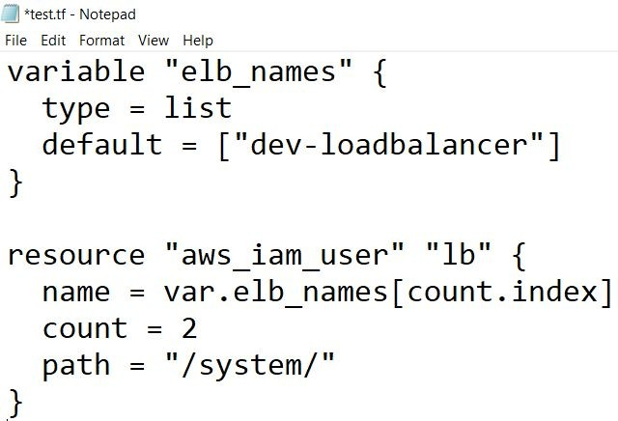

Terraform Code in NotePad!
You can write Terraform code in Notepad and it will not have any impact.
Downsides:
Slower Development
Limited Features

Slide 28
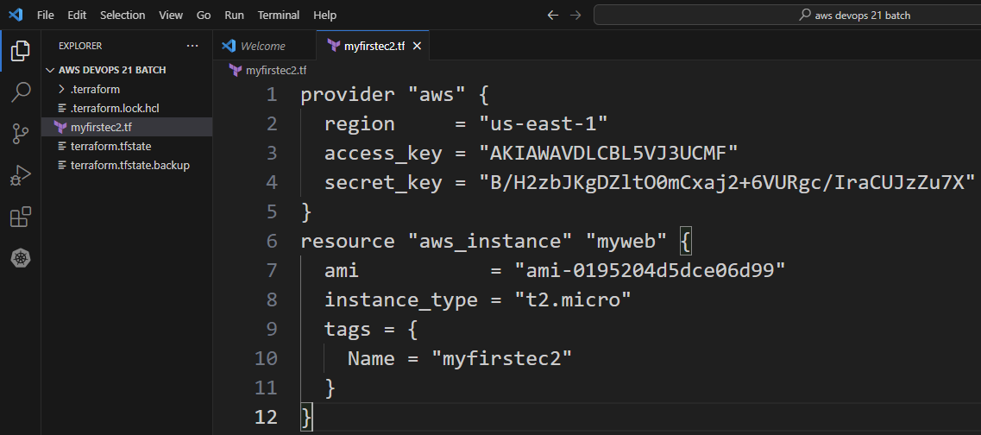
Need of a Better Software
There is a need of a better application that allows us to develop code faster.

Slide 29
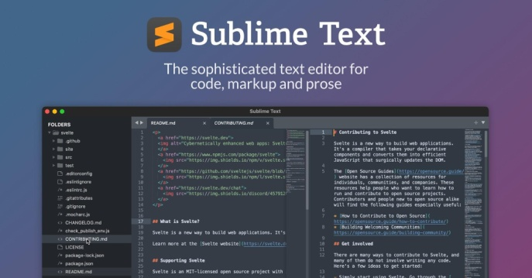
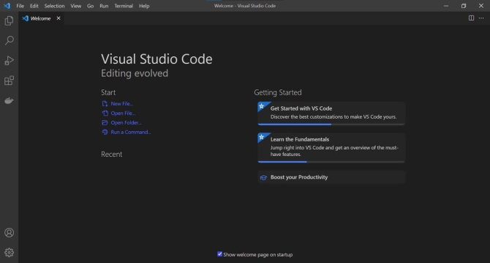
What are the Options!
There are many popular source code editors available in the market.
Source Code Editors

Slide 30
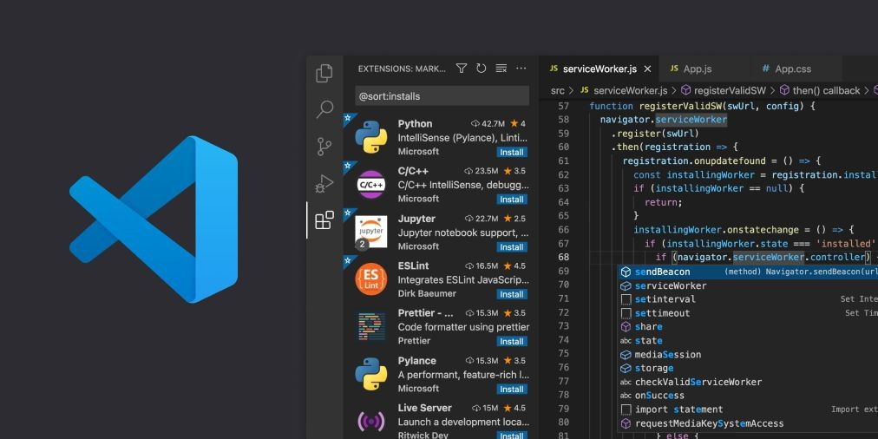
Editor for This Course
We are going to make use of Visual Studio Code as primary editor in this course.
Advantages:
Supports Windows, Mac, Linux
Supports Wide variety of programming languages.
Many Extensions.

Slide 31


Slide 32
Visual Studio Code Extensions

Slide 33
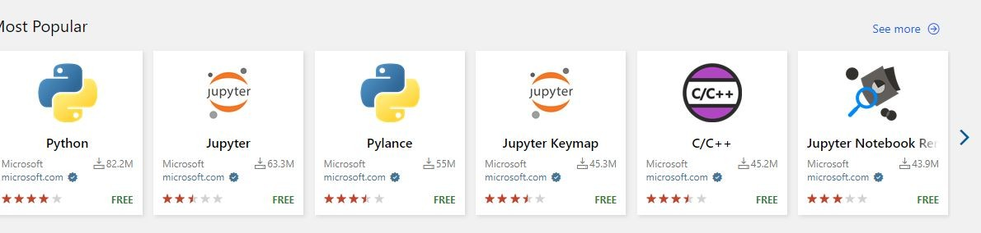
Understanding the Basics
Extensions are add-ons that allow you to customize and enhance your experience in Visual Studio by adding new features or integrating existing tools
They offer wide range of functionality related to colors, auto-complete, report spelling errors etc.

Slide 34
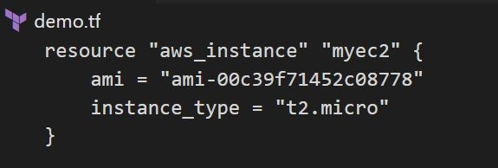
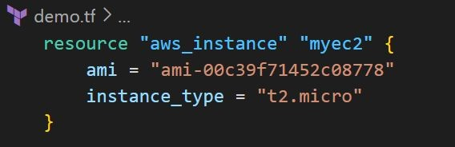
Terraform Extension
HashiCorp also provides extension for Terraform for Visual Studio Code.

Slide 35
Setting up the Lab
Let’s start Rolling !

Slide 36

Let’s Start
i) Create a new AWS Account.
ii) Begin the course

Slide 37
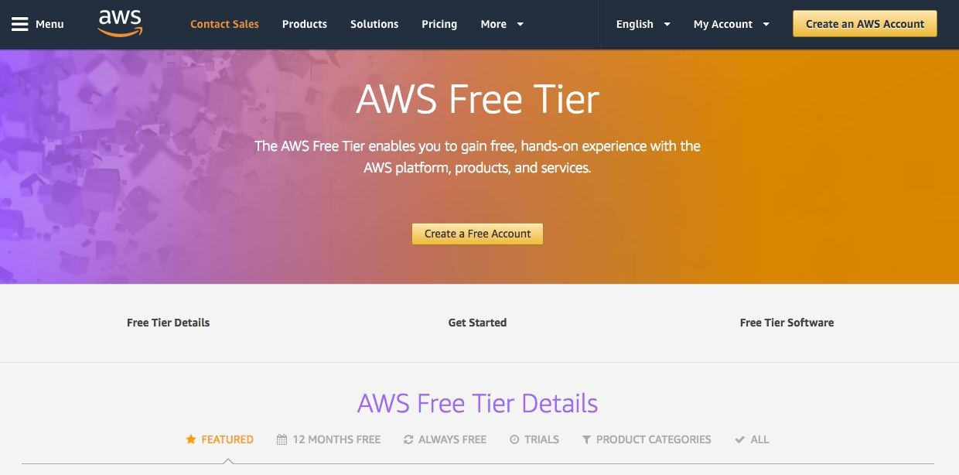
Registering an AWS Account

Slide 38

Authentication and Authorization

Slide 39

Understanding the Basics
Before we start working on managing environments through Terraform, the first important step is related to Authentication and Authorization.
Create new Server
AWS Cloud
Terraform
Dude, Authenticate First

Slide 40
Basics of Authentication and Authorization
Authentication is the process of verifying who a user is.
Authorization is the process of verifying what they have access to
Example:
Alice is a user in AWS with no access to any service.

Slide 41

Learning for Todays’ Video
Terraform needs access credentials with relevant permissions to create and manage the environments.
Create new Server
Terraform
Done
username | password
Bob | pwd928#

Slide 42
Access Credentials
Depending on the provider, the type of access credentials would change.
Provider | Access Credentials
AWS | Access Keys and Secret Keys
GitHub | Tokens
Kubernetes | Kubeconfig file, Credentials Config
Digital Ocean | Tokens

Slide 43

First Virtual Machine Through Terraform

Slide 44

Revising the Basics of EC2
EC2 stands for Elastic Compute Cloud.
In-short, it's a name for a virtual server that you launch in AWS.
VM
EC2 Instance

Slide 45
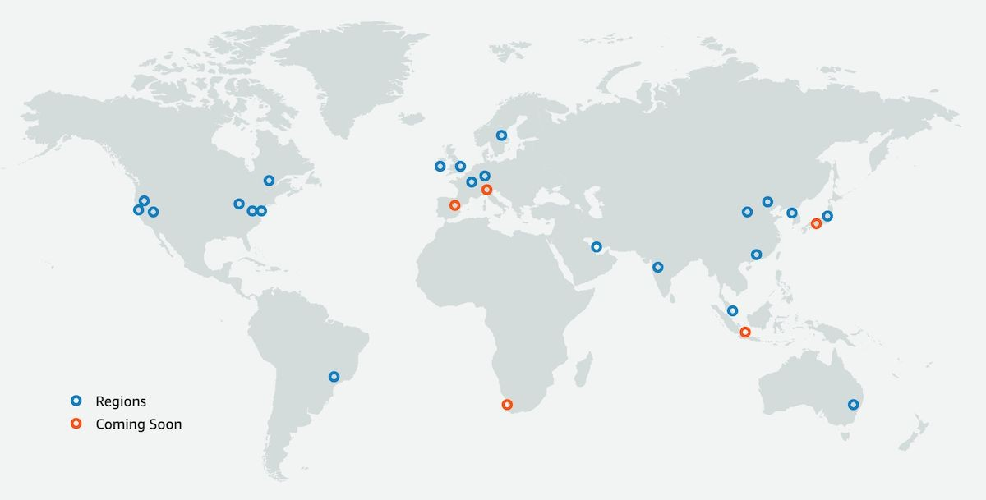
Available Regions
Cloud providers offers multiple regions in which we can create our resource.
You need to decide the region in which Terraform would create the resource.

Slide 46
Virtual Machine Configuration
A Virtual Machine would have it’s own set of configurations.
CPU
Memory
Storage
Operating System
While creating VM through Terraform, you will need to define these.

Slide 47
Providers and Resources

Slide 48
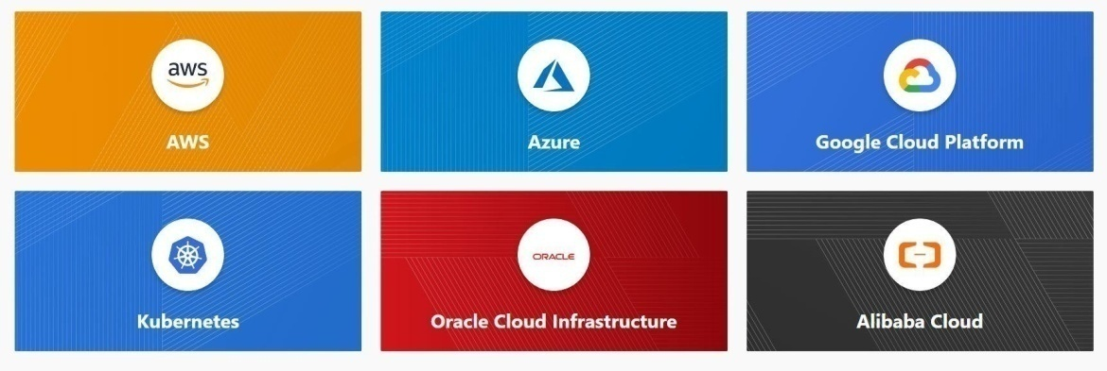
Basics of Providers
Terraform supports multiple providers.
Depending on what type of infrastructure we want to launch, we have to use appropriate providers accordingly.

Slide 49
Learning 1 - Provider Plugins
A provider is a plugin that lets Terraform manage an external API.
When we run terraform init, plugins required for the provider are automatically downloaded and saved locally to a .terraform directory.

Slide 50
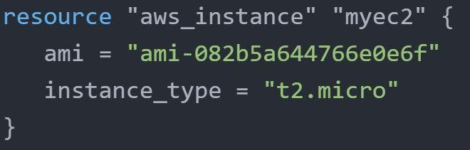
Learning 2 - Resource
Resource block describes one or more infrastructure objects
Example:
resource aws_instance
resource aws_alb
resource iam_user
resource digitalocean_droplet

Slide 51
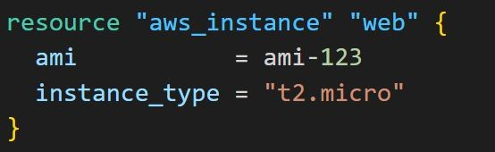
Learning 3 - Resource Blocks
A resource block declares a resource of a given type ("aws_instance") with a given local name ("myec2").
Resource type and Name together serve as an identifier for a given resource and so must be unique.
EC2 Instance Number 1
EC2 Instance Number 2

Slide 52
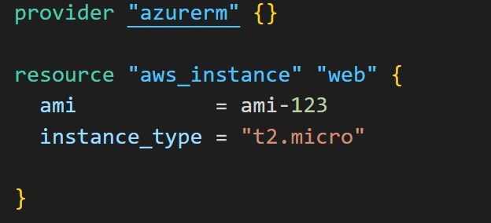
Point to Note
You can only use the resource that are supported by a specific provider.
In the below example, provider of Azure is used with resource of aws_instance

Slide 53

Important Question
The core concepts, standard syntax remains similar across all providers.
If you learn the basics, you should be able to work with all providers easily.

Slide 54
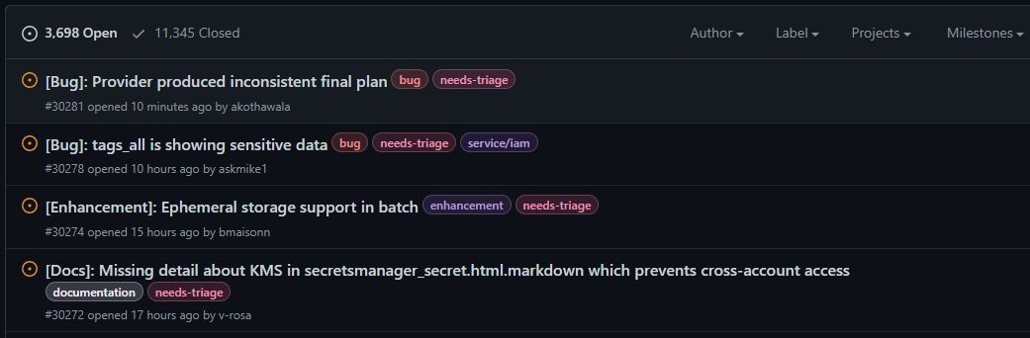
Issues and Bugs with Providers
A provider that is maintained by HashiCorp does not mean it has no bugs.
It can happen that there are inconsistencies from your output and things mentioned in documentation. You can raise issue at Provider page.

Slide 55

Relax and Have a Meme Before Proceeding

Slide 56

Provider Tiers

Slide 57
Provider Maintainers
There are 3 primary type of provider tiers in Terraform.
Provider Tiers | Description
Official | Owned and Maintained by HashiCorp.
Partner | Owned and Maintained by Technology Company that maintains direct partnership with HashiCorp.
Community | Owned and Maintained by Individual Contributors.

Slide 58
Provider Namespace
Namespaces are used to help users identify the organization or publisher responsible for the integration
Tier | Description
Official | hashicorp
Partner | Third-party organization e.g. mongodb/mongodbatlas
Community | Maintainer’s individual or organization account, e.g. DeviaVir/gsuite

Slide 59
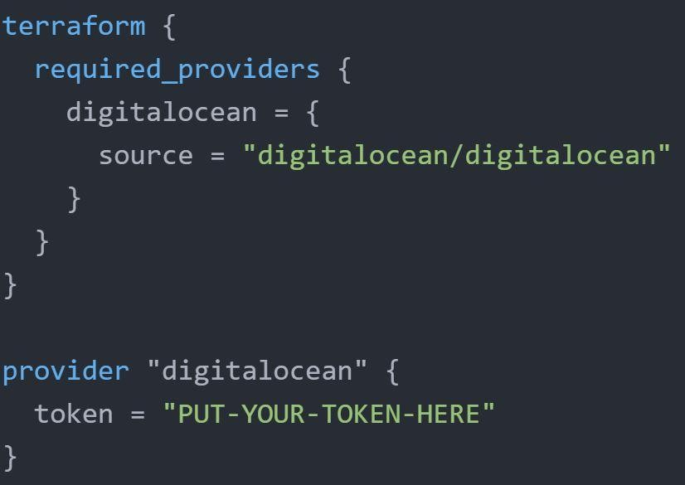
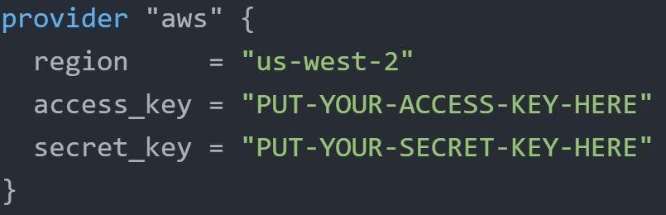
Important Learning
Terraform requires explicit source information for any providers that are not HashiCorp-maintained, using a new syntax in the required_providers nested block inside the terraform configuration block
HashiCorp Maintained
Non-HashiCorp Maintained

Slide 60
Terraform Destroy

Slide 61



Learning to Destroy Resources
If you keep the infrastructure running, you will get charged for it.
Hence it is important for us to also know on how we can delete the infrastructure resources created via terraform.
Terraform

Slide 62

Approach 1 - Destroy ALL
terraform destroy allows us to destroy all the resource that are created within the folder.
terraform destroy
Terraform

Slide 63
Approach 2 - Destroy Some
terraform destroy with -target flag allows us to destroy specific resource.
terraform destroy - target aws_instance.myec2
Terraform

Slide 64
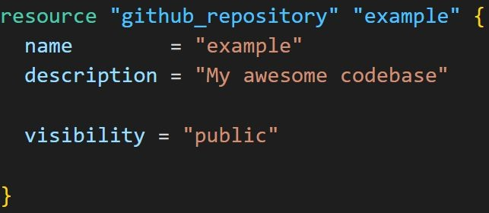
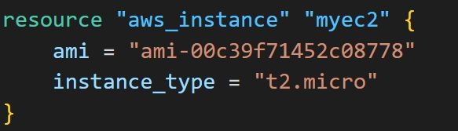
Terraform Destroy with Target
The -target option can be used to focus Terraform's attention on only a subset of resources.
Combination of : Resource Type + Local Resource Name
Resource Type | Local Resource Name
aws_instance | myec2
github_repository | example

Slide 65
Desired & Current State
Terraform in detail

Slide 66
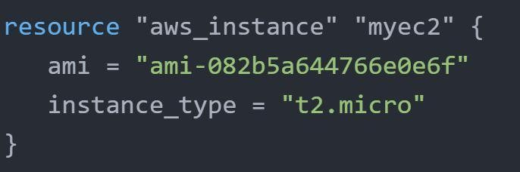

Desired State
Terraform's primary function is to create, modify, and destroy infrastructure resources to match the desired state described in a Terraform configuration
EC2 - t2.micro

Slide 67

Current State
Current state is the actual state of a resource that is currently deployed.
t2.medium

Slide 68

Important Pointer
Terraform tries to ensure that the deployed infrastructure is based on the desired state.
If there is a difference between the two, terraform plan presents a description of the changes necessary to achieve the desired state.

Slide 69
Provider Versioning
Terraform in detail

Slide 70




Provider Architecture
Infrastructure Provisioning
(API interactions)
do_droplet.tf
Terraform
Digital Ocean Provider
New Server
Digital Ocean

Slide 71


Overview of Provider Versioning
Provider plugins are released separately from Terraform itself.
They have different set of version numbers.
.
Version 1
Version 2

Slide 72
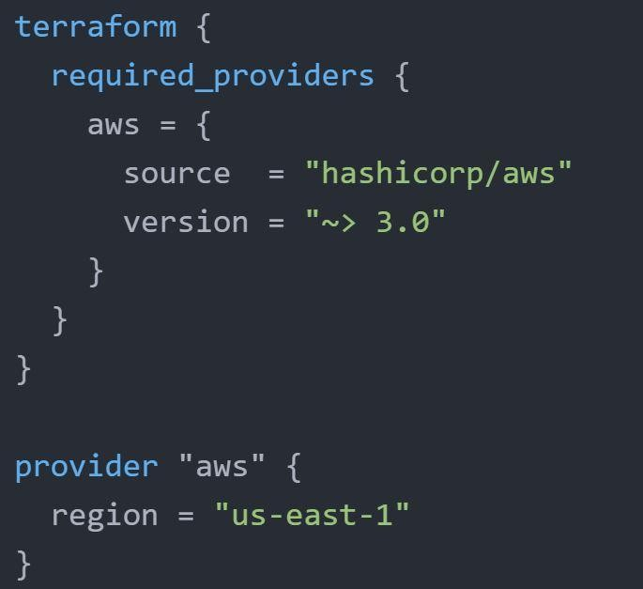
Explicitly Setting Provider Version
During terraform init, if version argument is not specified, the most recent provider will be downloaded during initialization.
For production use, you should constrain the acceptable provider versions via configuration, to ensure that new versions with breaking changes will not be automatically installed.

Slide 73
Arguments for Specifying provider
There are multiple ways for specifying the version of a provider.
Version Number Arguments | Description
>=1.0 | Greater than equal to the version
<=1.0 | Less than equal to the version
~>2.0 | Any version in the 2.X range.
>=2.10,<=2.30 | Any version between 2.10 and 2.30

Slide 74
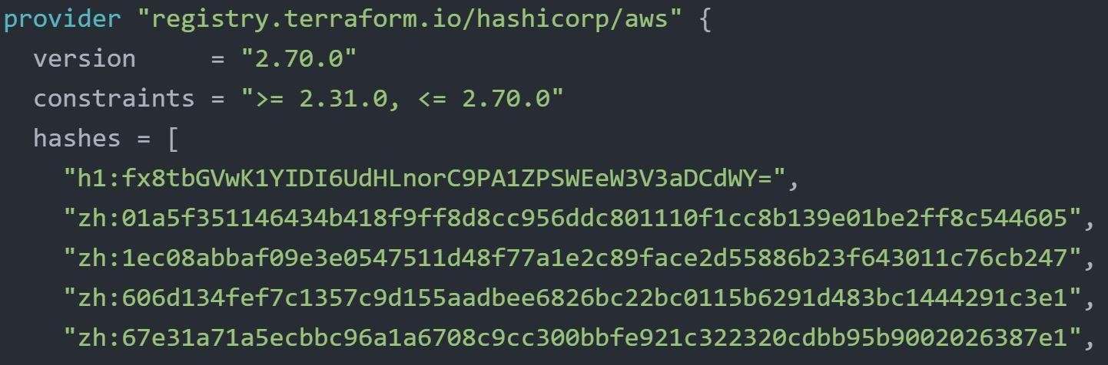
Dependency Lock File
Terraform dependency lock file allows us to lock to a specific version of the provider.
If a particular provider already has a selection recorded in the lock file, Terraform will always re-select that version for installation, even if a newer version has become available.
You can override that behavior by adding the -upgrade option when you run terraform init,

Slide 75
Terraform Refresh

Slide 76
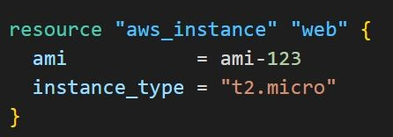


Understanding the Challenge
Terraform can create an infrastructure based on configuration you specified.
It can happen that the infrastructure gets modified manually.
t2.micro
EC2:
type: t2.micro
State File
storage: 20 sg: default

Slide 77

Understanding the Challenge
The terraform refresh command will check the latest state of your infrastructure and update the state file accordingly.
terraform refresh
Scan real infra
t2.large
EC2:
type: t2.large
State File
storage: 20 sg: default

Slide 78
Points to Note
You shouldn't typically need to use this command, because Terraform automatically performs the same refreshing actions as a part of creating a plan in both the terraform plan and terraform apply commands.

Slide 79
Understanding the Usage
The terraform refresh command is deprecated in newer version of terraform.
The -refresh-only option for terraform plan and terraform apply was introduced in Terraform v0.15.4.

Slide 80
AWS Provider - Authentication Configuration

Slide 81
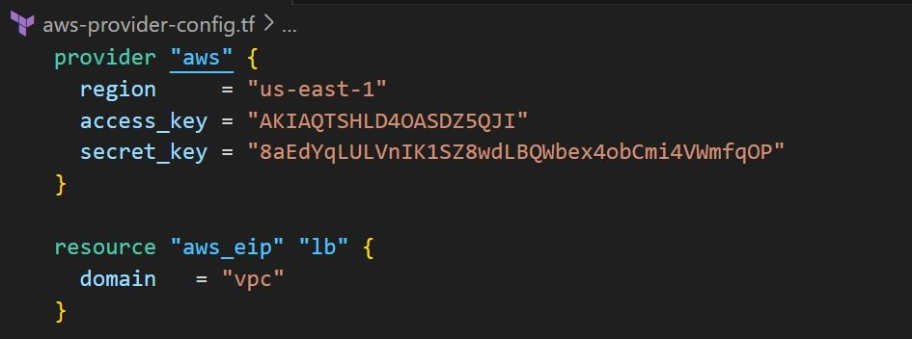
Understanding the Basics
At this stage, we have been manually hardcoding the access / secret keys within the provider block.
Although a working solution, but it is not optimal from security point of view.

Slide 82
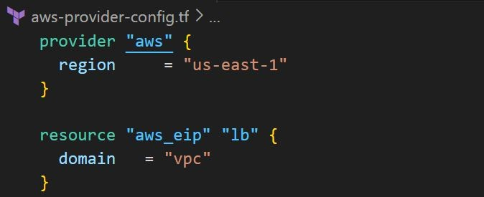
Better Way
We want our code to run successfully without hardcoding the secrets in the provider block.

Slide 83
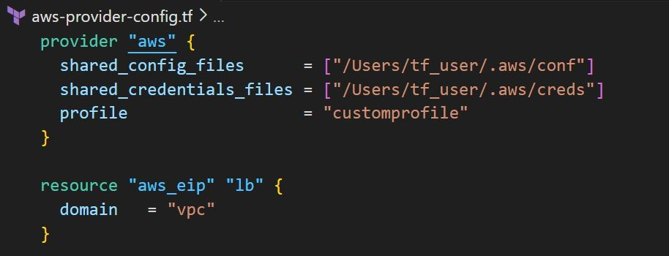
Better Approach
The AWS Provider can source credentials and other settings from the shared configuration and credentials files.

Slide 84
Default Configurations
If shared files lines are not added to provider block, by default, Terraform will locate these files at $HOME/.aws/config and $HOME/.aws/credentials on Linux and macOS.
"%USERPROFILE%\.aws\config" and "%USERPROFILE%\.aws\credentials" on Windows.

Slide 85
AWS CLI
AWS CLI allows customers to manage AWS resources directly from CLI.
When you configure Access/Secret keys in AWS CLI, the location in which these credentials are stored is the same default location that Terraform searches the credentials from.
Create EC2 Instance
awscli
AWS Platform

Slide 86
Lecture Format - Terraform Course
Terraform in detail

Slide 87
Overview of the Format
We tend to use a different folder for each practical that we do in the course.
This allows us to be more systematic and allows easier revisit in-case required.
Lecture Name | Folder Names
Create First EC2 Instance | folder1
Tainting resource | folder2
Conditional Expression | folder3

Slide 88
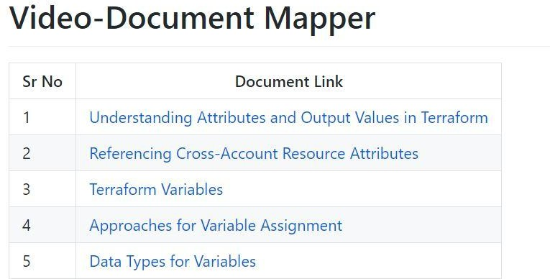
Find the appropriate code from GitHub
Code in GitHub is arranged according to sections that are matched to the domains in the course.
Every section in GitHub has easy Readme file for quick navigation.

Slide 89
Destroy Resource After Practical
We know how to destroy resources by now
terraform destroy
After you have completed your practical, make sure you destroy the resource before moving to the next practical.
This is easier if you are maintaining separate folder for each practical.

Slide 90

Relax and Have a Meme Before Proceeding

Slide 91
Cross-Resource Attribute References

Slide 92


Typical Challenge
It can happen that in a single terraform file, you are defining two different resources.
However Resource 2 might be dependent on some value of Resource 1.
Allow 443 from Elastic IP
Elastic IP Address

Slide 93
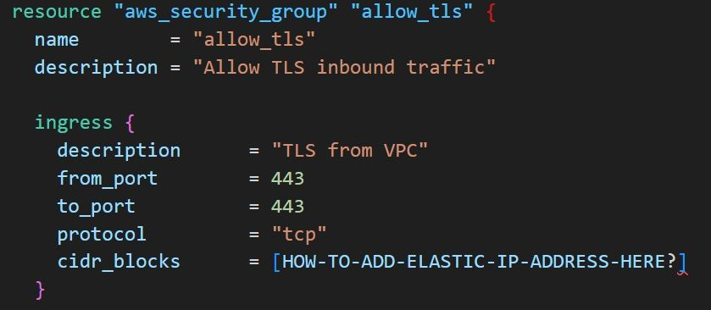
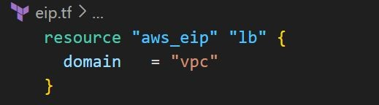
Understanding The Workflow
Elastic IP
Allow 443 from 52.72.30.50
52.72.30.50

Slide 94
Basics of Attributes
Each resource has its associated set of attributes.
Attributes are the fields in a resource that hold the values that end up in state.
Attributes | Values
ID | i-abcd
public_ip | 52.74.32.50
private_ip | 172.31.10.50
private_dns | ip-172-31-10-50-.ec2.internal

Slide 95
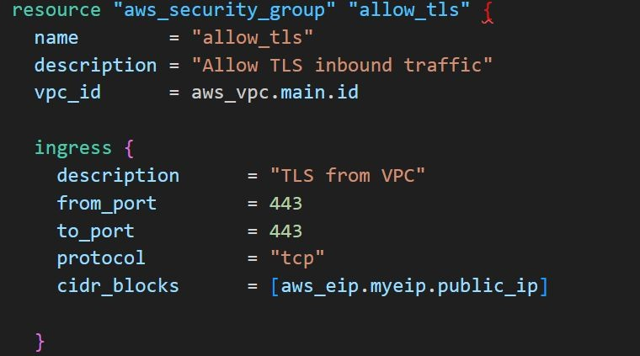
Cross Referencing Resource Attribute
Terraform allows us to reference the attribute of one resource to be used in a different resource.
Elastic IP
Attribute | Value
public_ip | 52.72.52.72

Slide 96
Output Values

Slide 97

Understanding the Basics
Output values make information about your infrastructure available on the command line, and can expose information for other Terraform configurations to use.
Create EC2 and give me it’s Public IP
Create EC2
Terraform
IP Of EC2: 172.32.10.50
Fetch Info of EC2

Slide 98
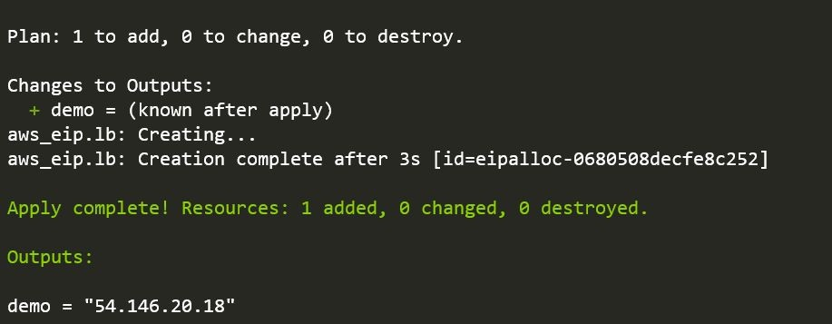
Sample Example
Use-Case:
Create a Elastic IP (Public IP) resource in AWS and output the value of the EIP.

Slide 99

Point to Note
Output values defined in Project A can be referenced from code in Project B as well.
Fetch
Output Values
Ip = 54.146.20.28
TF Code
Project B
Project A

Slide 100
Terraform Variables
Terraform in detail

Slide 101
Static = Work
Repeated static values can create more work in the future.
116.75.30.50
116.75.30.50
116.75.30.50
116.75.30.50
116.75.30.50
116.75.30.50
Project A
Project B

Slide 102
Variables are good
We can have a central source from which we can import the values from.
var.source
116.75.30.50
var.source
128.30.50.90
source
var.source

Slide 103
Variables are good
We can have a central source from which we can import the values from.
var.source
116.75.30.50
var.source
128.30.50.90
vpn_ip
var.source

Slide 104
Approaches to Variable Assignment
Terraform in detail

Slide 105
Multiple Approaches to Variable Assignment
Variables in Terraform can be assigned values in multiple ways.
Some of these include:
Environment variables
Command Line Flags
From a File
Variable Defaults
knowledge portal

Slide 106
Data Types for Variables
Terraform in detail

Slide 107
Overview of Type Constraints
The type argument in a variable block allows you to restrict the type of value that will be accepted as the value for a variable
variable "image_id" {
type = string
}
If no type constraint is set then a value of any type is accepted.

Slide 108
Example Use-Case
Every employee in Medium Corp is assigned a Identification Number.
Any resource that employee creates should be created with the name of the identification number only.
variables.tf | terraform.tfvars
variable “instance_name” {} | instance_name=”john-123”

Slide 109
Example Use-Case
Every employee in Medium Corp is assigned a Identification Number.
Any EC2 instance that employee creates should be created using the identification number only.
variables.tf | terraform.tfvars
variable “instance_name” { type=number } | instance_name=”john-123”

Slide 110
Overview of Data Types
Type Keywords | Description
string | Sequence of Unicode characters representing some text, like "hello".
list | Sequential list of values identified by their position. Starts with 0 [“mumbai” ,”singapore”, ”usa”]
map | a group of values identified by named labels, like {name = "Mabel", age = 52}.
number | Example: 200

Slide 111
Count Parameter
Terraform in detail

Slide 112
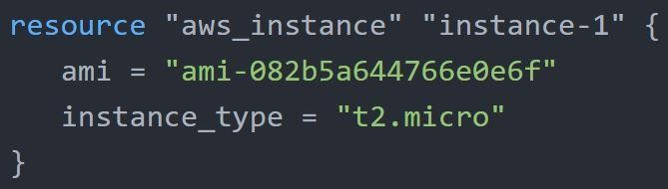
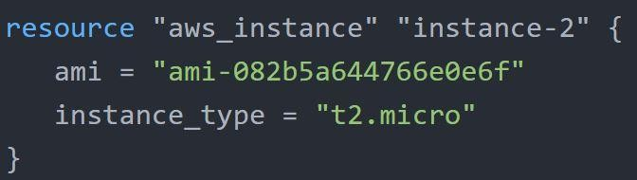
Overview of Count Parameter
The count parameter on resources can simplify configurations and let you scale resources by simply incrementing a number.
Let’s assume, you need to create two EC2 instances. One of the common approach is to define two separate resource blocks for aws_instance.
knowledge portal

Slide 113
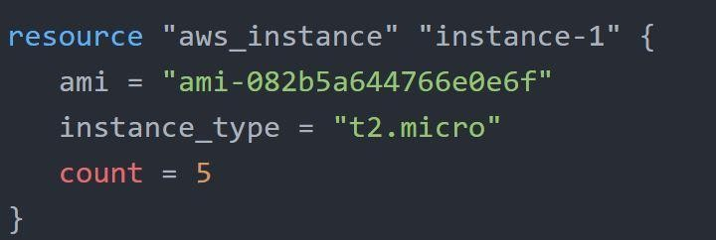
Overview of Count Parameter
With count parameter, we can simply specify the count value and the resource can be scaled accordingly.
knowledge portal

Slide 114
Count Index
In resource blocks where count is set, an additional count object is available in expressions, so you can modify the configuration of each instance.
This object has one attribute:
count.index — The distinct index number (starting with 0) corresponding to this instance.
knowledge portal

Slide 115
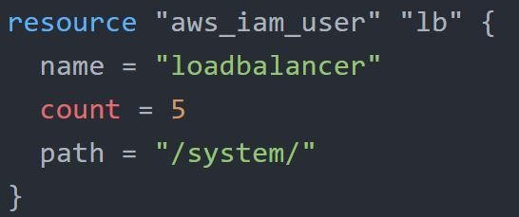
Understanding Challenge with Count
With the below code, terraform will create 5 IAM users. But the problem is that all will have the same name.
knowledge portal

Slide 116
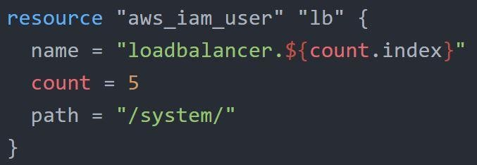
Understanding Challenge with Count
count.index allows us to fetch the index of each iteration in the loop.
knowledge portal

Slide 117
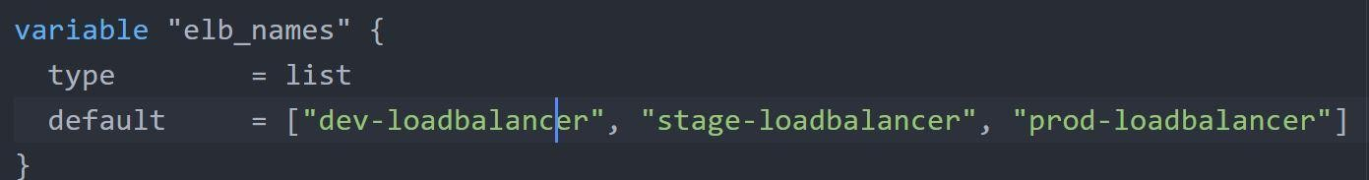
Understanding Challenge with Default Count Index
Having a username like loadbalancer0, loadbalancer1 might not always be suitable.
Better names like dev-loadbalancer, stage-loadbalancer, prod-loadbalancer is better. count.index can help in such scenario as well.
knowledge portal

Slide 118
Conditional Expression
Terraform in detail

Slide 119
Overview of Conditional Expression
A conditional expression uses the value of a bool expression to select one of two values.
Syntax of Conditional expression:
condition ? true_val : false_val
If condition is true then the result is true_val. If condition is false then the result is false_val.
knowledge portal

Slide 120
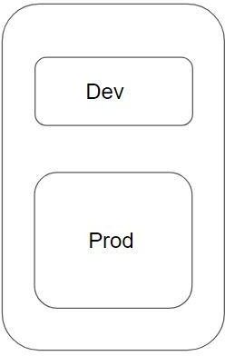
Example of Conditional Expression
Let’s assume that there are two resource blocks as part of terraform configuration.
Depending on the variable value, one of the resource blocks will run.
true
is- test
variable
false
knowledge portal

Slide 121
Local Values
Terraform in detail

Slide 122
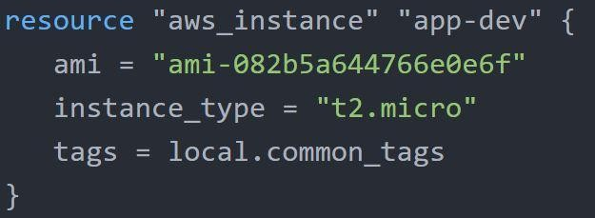
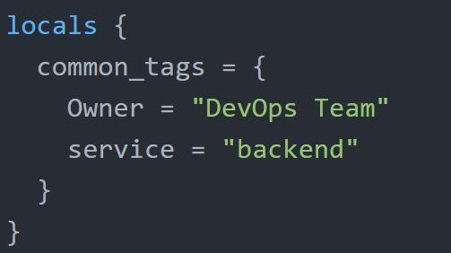
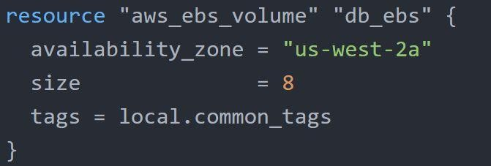
Overview of Local Values
A local value assigns a name to an expression, allowing it to be used multiple times within a module without repeating it.
knowledge portal

Slide 123
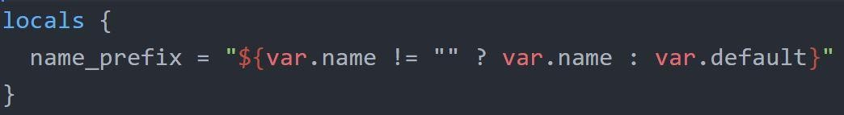
Local Values Support for Expression
Local Values can be used for multiple different use-cases like having a conditional expression.
knowledge portal

Slide 124
Important Pointers for Local Values
Local values can be helpful to avoid repeating the same values or expressions multiple times in a configuration.
If overused they can also make a configuration hard to read by future maintainers by hiding the actual values used
Use local values only in moderation, in situations where a single value or result is used in many places and that value is likely to be changed in future.
knowledge portal

Slide 125
Terraform Functions
Terraform in detail

Slide 126
Overview of Terraform Functions
The Terraform language includes a number of built-in functions that you can use to transform and combine values.
The general syntax for function calls is a function name followed by comma-separated arguments in parentheses:
function (argument1, argument2) Example:
> max(5, 12, 9)
12
knowledge portal

Slide 127
List of Available Functions
The Terraform language does not support user-defined functions, and so only the functions built in to the language are available for use
Numeric
String
Collection
Encoding
Filesystem
Date and Time
Hash and Crypto
IP Network
Type Conversion
knowledge portal

Slide 128
Data Sources
Terraform in detail

Slide 129


Overview of Data Sources
Data sources allow data to be fetched or computed for use elsewhere in Terraform configuration.
EC2 Instance
Mumbai Region
Singapore Region
Tokyo Region
ami-1234
ami-5678
ami-9012

Slide 130
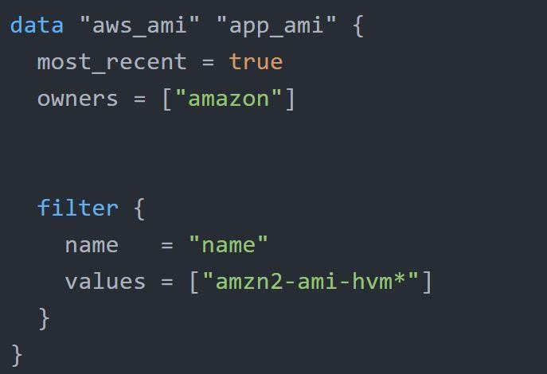
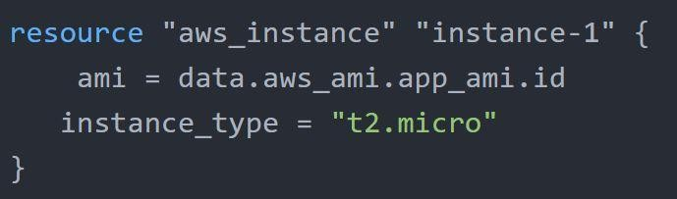
Data Source Code
Defined under the data block.
Reads from a specific data source (aws_ami) and exports results under “app_ami”
knowledge portal

Slide 131
Debugging Terraform
Terraform in detail

Slide 132
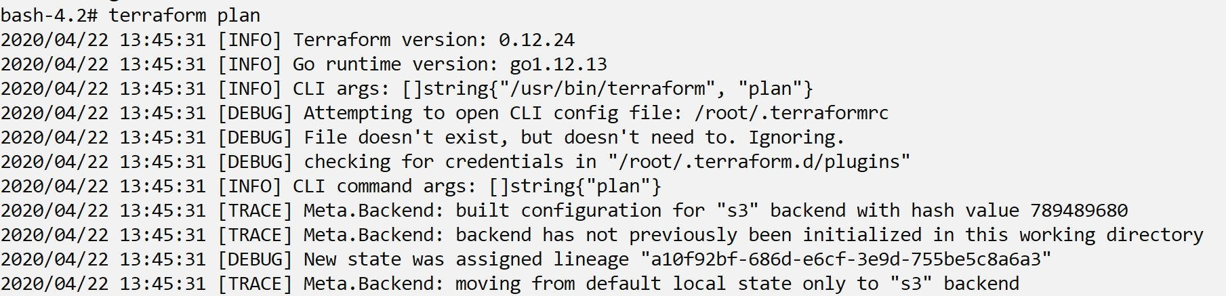
Overview of Debugging Terraform
Terraform has detailed logs which can be enabled by setting the TF_LOG environment variable to any value.
You can set TF_LOG to one of the log levels TRACE, DEBUG, INFO, WARN or ERROR to change the verbosity of the logs
knowledge portal

Slide 133
Important Pointers
TRACE is the most verbose and it is the default if TF_LOG is set to something other than a log level name.
To persist logged output you can set TF_LOG_PATH in order to force the log to always be appended to a specific file when logging is enabled.

Slide 134
Lecture Format - Terraform Course
Terraform in detail

Slide 135
Overview of the Format
We tend to use a different folder for each practical that we do in the course.
This allows us to be more systematic and allows easier revisit in-case required.
Lecture Name | Folder Names
Create First EC2 Instance | folder1
Tainting resource | folder2
Conditional Expression | folder3

Slide 136
Find the appropriate code from GitHub
Code in GitHub is arranged according to sections that are matched to the domains in the course.
Every section in GitHub has easy Readme file for quick navigation.

Slide 137
Destroy Resource After Practical
We know how to destroy resources by now
terraform destroy
After you have completed your practical, make sure you destroy the resource before moving to the next practical.
This is easier if you are maintaining separate folder for each practical.

Slide 138

Relax and Have a Meme Before Proceeding
knowledge portal

Slide 139
Terraform Format
Terraform in detail

Slide 140

Importance of Readability
Anyone who is into programming knows the importance of formatting the code for readability.
The terraform fmt command is used to rewrite Terraform configuration files to take care of the overall formatting.

Slide 141

Before fmt
After fmt

Slide 142
Terraform Validate
Terraform in detail

Slide 143


Overview of Terraform Validate
Terraform Validate primarily checks whether a configuration is syntactically valid.
It can check various aspects including unsupported arguments, undeclared variables and others.

Slide 144
Load Order & Semantics
Terraform in detail

Slide 145
Understanding Semantics
Terraform generally loads all the configuration files within the directory specified in alphabetical order.
The files loaded must end in either .tf or .tf.json to specify the format that is in use.
terraform-kplabs
web.tf
app.tf
sg.tf
providers.tf

Slide 146
Dynamic Block
Terraform In Depth

Slide 147


Understanding the Challenge
In many of the use-cases, there are repeatable nested blocks that needs to be defined.
This can lead to a long code and it can be difficult to manage in a longer time.
knowledge portal

Slide 148

Dynamic Blocks
Dynamic Block allows us to dynamically construct repeatable nested blocks which is supported inside resource, data, provider, and provisioner blocks:
knowledge portal

Slide 149

Iterators
The iterator argument (optional) sets the name of a temporary variable that represents the current element of the complex value
If omitted, the name of the variable defaults to the label of the dynamic block ("ingress" in the example above).
knowledge portal

Slide 150
Terraform Taint

Slide 151

Understanding the Use-Case
You have created a new resource via Terraform.
Users have made a lot of manual changes (both infrastructure and inside the server)
Two ways to deal with this: Import Changes to Terraform / Delete & Recreate the resource
Lots of manual changes
Terraform Managed Resource

Slide 152
Recreating the Resource
The -replace option with terraform apply to force Terraform to replace an object even though there are no configuration changes that would require it.
terraform apply -replace="aws_instance.web"
Destroy
Create

Slide 153
Points to Note
Similar kind of functionality was achieved using terraform taint command in older versions of Terraform.
For Terraform v0.15.2 and later, HashiCorp recommend using the -replace option with terraform apply

Slide 154
Splat Expression
Terraform Expressions

Slide 155

Overview of Spalat Expression
Splat Expression allows us to get a list of all the attributes.
knowledge portal

Slide 156
Terraform Graph
Terraform In Detail

Slide 157

Overview of Graph
The terraform graph command is used to generate a visual representation of either a configuration or execution plan
The output of terraform graph is in the DOT format, which can easily be converted to an image.
knowledge portal

Slide 158
Saving Terraform Plan to a File
Terraform In Detail

Slide 159
Terraform Plan File
The generated terraform plan can be saved to a specific path.
This plan can then be used with terraform apply to be certain that only the changes shown in this plan are applied.
Example:
terraform plan -out=path
knowledge portal

Slide 160
Terraform Output
Terraform in detail

Slide 161

Terraform Output
The terraform output command is used to extract the value of an output variable from the state file.
knowledge portal

Slide 162
Terraform Settings
Terraform in detail

Slide 163

Overview of Terraform Settings
The special terraform configuration block type is used to configure some behaviors of Terraform itself, such as requiring a minimum Terraform version to apply your configuration.
Terraform settings are gathered together into terraform blocks:
knowledge portal

Slide 164

Setting 1 - Terraform Version
The required_version setting accepts a version constraint string, which specifies which versions of Terraform can be used with your configuration.
If the running version of Terraform doesn't match the constraints specified, Terraform will produce an error and exit without taking any further actions.
knowledge portal

Slide 165

Setting 2 - Provider Version
The required_providers block specifies all of the providers required by the current module, mapping each local provider name to a source address and a version constraint.
knowledge portal

Slide 166
Dealing with Larger Infrastructure
Terraform in detail

Slide 167

Challenges with Larger Infrastructure
When you have a larger infrastructure, you will face issue related to API limits for a provider.
5 EC2
Update state of each resource.
terraform plan
3 RDS
100 SG Rules VPC Infra
infra.tf

Slide 168
Dealing With Larger Infrastructure
Switch to smaller configuration were each can be applied independently.
terraform plan
5 EC2
ec2.tf
5 EC2
terraform plan
3 RDS
rds.tf
3 RDS
100 SG Rules
100 SG Rules
sg.tf
VPC Infra
VPC Infra
vpc.tf
infra.tf

Slide 169

Slow Down, My Man
We can prevent terraform from querying the current state during operations like terraform plan.
This can be achieved with the -refresh=false flag

Slide 170

Specify the Target
The -target=resource flag can be used to target a specific resource.
Generally used as a means to operate on isolated portions of very large configurations
terraform plan -target=ec2

Slide 171
Zipmap
Terraform Function

Slide 172
Overview of Zipmap
The zipmap function constructs a map from a list of keys and a corresponding list of values.
pineapple
orange
strawberry
yellow
orange
red
pineapple=yellow
orange=orange
strawberry=red
zipmap
List of Keys
List of Values
knowledge portal

Slide 173

Sample Output of Zipmap Function
knowledge portal

Slide 174

Simple Use-Case
You are creating multiple IAM users.
You need output which contains direct mapping of IAM names and ARNs
knowledge portal

Slide 175
Comments in Terraform Code
Commenting the Code!

Slide 176

Overview of Comments
A comment is a text note added to source code to provide explanatory information, usually about the function of the code
knowledge portal

Slide 177
Comments in Terraform
The Terraform language supports three different syntaxes for comments:
Type | Description
# | begins a single-line comment, ending at the end of the line.
// | also begins a single-line comment, as an alternative to #.
/* and */ | are start and end delimiters for a comment that might span over multiple lines.
knowledge portal

Slide 178
Resource Behavior and Meta-Argument

Slide 179

Understanding the Basics
A resource block declares that you want a particular infrastructure object to exist with the given settings

Slide 180
How Terraform Applies a Configuration
Create resources that exist in the configuration but are not associated with a real infrastructure object in the state.
Destroy resources that exist in the state but no longer exist in the configuration. Update in-place resources whose arguments have changed.
Destroy and re-create resources whose arguments have changed but which cannot be updated in-place due to remote API limitations.

Slide 181


Understanding the Limitations
What happens if we want to change the default behavior?
Example: Some modification happened in Real Infrastructure object that is not part of Terraform but you want to ignore those changes during terraform apply.
Name
HelloWorld
Env
Production

Slide 182

Solution - Using Meta Arguments
Terraform allows us to include meta-argument within the resource block which allows some details of this standard resource behavior to be customized on a per-resource basis.
Inside resource block

Slide 183
Different Meta-Arguments
Meta-Argument | Description
depends_on | Handle hidden resource or module dependencies that Terraform cannot automatically infer.
count | Accepts a whole number, and creates that many instances of the resource
for_each | Accepts a map or a set of strings, and creates an instance for each item in that map or set.
lifecycle | Allows modification of the resource lifecycle.
provider | Specifies which provider configuration to use for a resource, overriding Terraform's default behavior of selecting one based on the resource type name

Slide 184
Meta Argument - LifeCycle

Slide 185

Basics of Lifecycle Meta-Argument
Some details of the default resource behavior can be customized using the special nested lifecycle block within a resource block body:

Slide 186
Arguments Available
There are four argument available within lifecycle block.
Arguments | Description
create_before_destroy | New replacement object is created first, and the prior object is destroyed after the replacement is created.
prevent_destroy | Terraform to reject with an error any plan that would destroy the infrastructure object associated with the resource
ignore_changes | Ignore certain changes to the live resource that does not match the configuration.
replace_triggered_by | Replaces the resource when any of the referenced items change

Slide 187

Replace Triggered By
Replaces the resource when any of the referenced items change.

Slide 188
Create Before Destroy Argument

Slide 189



Understanding the Default Behavior
By default, when Terraform must change a resource argument that cannot be updated in-place due to remote API limitations, Terraform will instead destroy the existing object and then create a new replacement object with the new configured arguments.
Destroy First
Changed AMI
Create Second

Slide 190


Create Before Destroy Argument
The create_before_destroy meta-argument changes this behavior so that the new replacement object is created first, and the prior object is destroyed after the replacement is created.
Destroy Second
Changed AMI
Create First

Slide 191


Join us in our Adventure
kplabs.in/chat
Be Awesome
kplabs.in/linkedin

Slide 192
LifeCycle - Prevent Destroy Argument

Slide 193

Prevent Destroy Argument
This meta-argument, when set to true, will cause Terraform to reject with an error any plan that would destroy the infrastructure object associated with the resource, as long as the argument remains present in the configuration.

Slide 194
Points to Note
This can be used as a measure of safety against the accidental replacement of objects that may be costly to reproduce, such as database instances.
Since this argument must be present in configuration for the protection to apply, note that this setting does not prevent the remote object from being destroyed if the resource block were removed from configuration entirely.

Slide 195
LifeCycle - Ignore Changes Argument

Slide 196
Ignore Changes
In cases where settings of a remote object is modified by processes outside of Terraform, the Terraform would attempt to "fix" on the next run.
In order to change this behavior and ignore the manually applied change, we can make use of ignore_changes argument under lifecycle.

Slide 197

Points to Note
Instead of a list, the special keyword all may be used to instruct Terraform to ignore all attributes, which means that Terraform can create and destroy the remote object but will never propose updates to it.

Slide 198
Challenges with Count
Meta-Argument

Slide 199

Revising the Basics
Resource are identified by the index value from the list.
Resource Address | Infrastructure
aws_iam_user.iam[0] | user-01
aws_iam_user.iam[1] | user-02
aws_iam_user.iam[2] | user-03
knowledge portal

Slide 200

Challenge - 1
If the order of elements of index is changed, this can impact all of the other resources.
Resource Address | Infrastructure
aws_iam_user.iam.[0] | user-01
aws_iam_user.iam.[1] | user-02
aws_iam_user.iam.[2] | user-03
knowledge portal

Slide 201

Important Note
If your resources are almost identical, count is appropriate.
If distinctive values are needed in the arguments, usage of for_each is recommended.
knowledge portal

Slide 202
Data Type - SET
Let’s Revise Programming

Slide 203

Basics of List
Lists are used to store multiple items in a single variable.
List items are ordered, changeable, and allow duplicate values.
List items are indexed, the first item has index [0], the second item has index [1] etc.
knowledge portal

Slide 204


Understanding SET
SET is used to store multiple items in a single variable.
SET items are unordered and no duplicates allowed.
Allowed
Not-Allowed
knowledge portal

Slide 205

toset Function
toset function will convert the list of values to SET
knowledge portal

Slide 206
for_each
Meta-Argument

Slide 207

Basics of For Each
for_each makes use of map/set as an index value of the created resource.
Resource Address | Infrastructure
aws_iam_user.iam[user-01] | user-01
aws_iam_user.iam[user-02] | user-02
aws_iam_user.iam[user-03] | user-03
knowledge portal

Slide 208

Replication Count Challenge
If a new element is added, it will not affect the other resources.
Resource Address | Infrastructure
aws_iam_user.iam[user-01] | user-01
aws_iam_user.iam[user-02] | user-02
aws_iam_user.iam[user-03] | user-03
aws_iam_user.iam[user-0] | user-0
knowledge portal

Slide 209
The each object
In blocks where for_each is set, an additional each object is available.
This object has two attributes:
Each object | Description
each.key | The map key (or set member) corresponding to this instance.
each.value | The map value corresponding to this instance
knowledge portal

Slide 210

Relax and Have a Meme Before Proceeding
knowledge portal

Slide 211
Provisioners
Interesting Part is here

Slide 212
Provisioners are interesting
Till now we have been working only on creation and destruction of infrastructure scenarios.
Let’s take an example:
We created a web-server EC2 instance with Terraform.
Problem: It is only an EC2 instance, it does not have any software installed.
What if we want a complete end to end solution ?
knowledge portal

Slide 213
Welcome to Terraform Provisioners
Provisioners are used to execute scripts on a local or remote machine as part of resource creation or destruction.
Let’s take an example:
On creation of Web-Server, execute a script which installs Nginx web-server.
Create EC2
Install Nginx
knowledge portal

Slide 214
Types of Provisioners
Interesting Part is here

Slide 215
Provisioners are interesting
Terraform has capability to turn provisioners both at the time of resource creation as well as destruction.
There are two main types of provisioners:
local-exec
remote-exec
knowledge portal

Slide 216
Local Exec Provisioners
local-exec provisioners allow us to invoke local executable after resource is created
Let’s take an example:
resource "aws_instance" "web" {
# …
provisioner "local-exec" {
command = "echo ${aws_instance.web.private_ip} >> private_ips.txt"
}
}
knowledge portal

Slide 217
Remote Exec Provisioners
Remote-exec provisioners allow to invoke scripts directly on the remote server.
Let’s take an example:
resource "aws_instance" "web" {
# …
provisioner "remote-exec" {
…………………………...
}
}
knowledge portal

Slide 218
Provisioner Types
Terraform in detail

Slide 219
Overview of Provisioner Types
There are two primary types of provisioners:
Types of Provisioners | Description
Creation-Time Provisioner | Creation-time provisioners are only run during creation, not during updating or any other lifecycle If a creation-time provisioner fails, the resource is marked as tainted.
Destroy-Time Provisioner | Destroy provisioners are run before the resource is destroyed.
knowledge portal

Slide 220

Destroy Time Provisioner
If when = destroy is specified, the provisioner will run when the resource it is defined within is destroyed.
knowledge portal

Slide 221
local-exec
Provisioners Time!

Slide 222
Provisioners are interesting
local-exec provisioners allows us to invoke a local executable after the resource is created.
One of the most used approach of local-exec is to run ansible-playbooks on the created server after the resource is created.
provisioner "local-exec" {
command = "echo ${aws_instance.web.private_ip} >> private_ips.txt"
}
knowledge portal

Slide 223
Failure Behavior - Provisioners
Terraform in detail

Slide 224

Provisioner - Failure Behaviour
By default, provisioners that fail will also cause the terraform apply itself to fail.
The on_failure setting can be used to change this. The allowed values are:
Allowed Values | Description
continue | Ignore the error and continue with creation or destruction.
fail | Raise an error and stop applying (the default behavior). If this is a creation provisioner, taint the resource.

Slide 225
DRY Principle
Software Engineering

Slide 226

Understanding DRY Approach
In software engineering, don't repeat yourself (DRY) is a principle of software development aimed at reducing repetition of software patterns.
In the earlier lecture, we were making static content into variables so that there can be single source of information.
knowledge portal

Slide 227
We are repeating resource code
We do repeat multiple times various terraform resources for multiple projects.
Sample EC2 Resource
resource "aws_instance" "myweb" {
ami = "ami-bf5540df" instance_type = "t2.micro" security_groups = ["default"]
}
knowledge portal

Slide 228
Centralized Structure
We can centralize the terraform resources and can call out from TF files whenever required.
module “source”
source
resource "aws_instance" "myweb" {
ami = "ami-bf5540df" instance_type = "t2.micro" security_groups = ["default"]
}
knowledge portal

Slide 229
Challenges with Modules
Software Engineering

Slide 230
Challenges
One common need on infrastructure management is to build environments like staging, production with similar setup but keeping environment variables different.
Staging
instance_type = t2.micro
Production
instance_type = m4.large
knowledge portal

Slide 231
Challenges
When we use modules directly, the resources will be replica of code in the module.
Development
t2.micro
source
Staging
t2.small
resource "aws_instance" "myweb" {
ami = "ami-bf5540df"
Production
m4.large
instance_type = "t2.micro"
security_groups = ["default"]
}
knowledge portal

Slide 232
Using Locals with Modules
Terraform Function

Slide 233
Understanding the Challenge
Using variables in Modules can also allow users to override the values which you might not want.
Development
instance_type = m5.xlarge
source
Staging
instance_type = m5.2xlarge
resource "aws_instance" "myweb" {
ami = "ami-bf5540df"
Production
instance_type = t2.medium
instance_type = var.instance_type
}
knowledge portal

Slide 234


Setting the Context
There can be many repetitive values in modules and this can make your code difficult to maintain.
You can centralize these using variables but users will be able to override it.
Hardcoded Port
Variable Port
knowledge portal

Slide 235

Using Locals
Instead of variables, you can make use of locals to assign the values.
You can centralize these using variables but users will be able to override it.
knowledge portal

Slide 236
Module Outputs
Output the Data

Slide 237

Revising Output Values
Output values make information about your infrastructure available on the command line, and can expose information for other Terraform configurations to use.
knowledge portal

Slide 238


Accessing Child Module Outputs
In a parent module, outputs of child modules are available in expressions as module.<MODULE NAME>.<OUTPUT NAME>
knowledge portal

Slide 239
Terraform Registry
Terraform in detail

Slide 240

Overview of Terraform Registry
The Terraform Registry is a repository of modules written by the Terraform community.
The registry can help you get started with Terraform more quickly
knowledge portal

Slide 241
Module Location
If we intend to use a module, we need to define the path where the module files are present.
The module files can be stored in multiple locations, some of these include:
Local Path
GitHub
Terraform Registry
S3 Bucket
HTTP URLs
knowledge portal

Slide 242

Verified Modules in Terraform Registry
Within Terraform Registry, you can find verified modules that are maintained by various third party vendors.
These modules are available for various resources like AWS VPC, RDS, ELB and others.
knowledge portal

Slide 243
Verified Modules in Terraform Registry
Verified modules are reviewed by HashiCorp and actively maintained by contributors to stay up-to-date and compatible with both Terraform and their respective providers.
The blue verification badge appears next to modules that are verified.
Module verification is currently a manual process restricted to a small group of trusted HashiCorp partners.
knowledge portal

Slide 244
Using Registry Module in Terraform
To use Terraform Registry module within the code, we can make use of the source argument that contains the module path.
Below code references to the EC2 Instance module within terraform registry.
module "ec2-instance" {
source = "terraform-aws-modules/ec2-instance/aws"
version = "2.13.0"
# insert the 10 required variables here
}
knowledge portal

Slide 245
Publishing Modules
Publish Modules to Terraform Registry

Slide 246

Overview of Publishing Modules
Anyone can publish and share modules on the Terraform Registry.
Published modules support versioning, automatically generate documentation, allow browsing version histories, show examples and READMEs, and more.
knowledge portal

Slide 247
Requirements for Publishing Module
Requirement | Description
GitHub | The module must be on GitHub and must be a public repo. This is only a requirement for the public registry.
Named | Module repositories must use this three-part name format terraform-<PROVIDER>-<NAME>
Repository description | The GitHub repository description is used to populate the short description of the module.
Standard module structure | The module must adhere to the standard module structure.
x.y.z tags for releases | The registry uses tags to identify module versions. Release tag names must be a semantic version, which can optionally be prefixed with a v. For example, v1.0.4 and 0.9.2
knowledge portal

Slide 248


Standard Module Structure
The standard module structure is a file and directory layout that is recommend for reusable modules distributed in separate repositories
knowledge portal

Slide 249
Terraform Workspace
Interesting topics

Slide 250
Understanding WorkSpaces
Terraform allows us to have multiple workspaces, with each of the workspace we can have different set of environment variables associated
Staging
instance_type = t2.micro
Production
instance_type = m4.large
Project A
knowledge portal

Slide 251
Team Collaboration
Terraform in detail

Slide 252


Local Changes are not always good
Currently we have been working with terraform code locally.
Terraform Code
………
………
knowledge portal

Slide 253
Centralized Management
Central Repository
Terraform Code
Terraform Code
………
………
………
………
knowledge portal

Slide 254

Relax and Have a Meme Before Proceeding
knowledge portal

Slide 255
Terraform Module Sources
Terraform in detail

Slide 256

Supported Module Sources
The source argument in a module block tells Terraform where to find the source code for the desired child module.
Local paths
Terraform Registry
GitHub
Bitbucket
Generic Git, Mercurial repositories
HTTP URLs
S3 buckets
GCS buckets
knowledge portal

Slide 257

Local Path
A local path must begin with either ./ or ../ to indicate that a local path is intended.
knowledge portal

Slide 258

Git Module Source
Arbitrary Git repositories can be used by prefixing the address with the special git:: prefix.
After this prefix, any valid Git URL can be specified to select one of the protocols supported by Git.
.
knowledge portal

Slide 259

Referencing to a Branch
By default, Terraform will clone and use the default branch (referenced by HEAD) in the selected repository.
You can override this using the ref argument:
.
The value of the ref argument can be any reference that would be accepted by the git checkout command, including branch and tag names.
knowledge portal

Slide 260
Terraform & GitIgnore
Terraform in detail

Slide 261

Overview of gitignore
The .gitignore file is a text file that tells Git which files or folders to ignore in a project.
.gitignore
conf/
*.artifacts
credentials
knowledge portal

Slide 262
Terraform and .gitignore
Depending on the environments, it is recommended to avoid committing certain files to GIT.
Files to Ignore | Description
.terraform | This file will be recreated when terraform init is run.
terraform.tfvars | Likely to contain sensitive data like usernames/passwords and secrets.
terraform.tfstate | Should be stored in the remote side.
crash.log | If terraform crashes, the logs are stored to a file named crash.log
knowledge portal

Slide 263
Terraform Backend
Terraform in detail

Slide 264


Basics of Backends
Backends primarily determine where Terraform stores its state.
By default, Terraform implicitly uses a backend called local to store state as a local file on disk.
demo.tf
terraform.tfstate
knowledge portal

Slide 265

Challenge with Local Backend
Nowadays Terraform project is handled and collaborated by an entire team.
Storing the state file in the local laptop will not allow collaboration.
knowledge portal

Slide 266


Ideal Architecture
Following describes one of the recommended architectures:
The Terraform Code is stored in Git Repository.
The State file is stored in a Central backend.
TF files
Central Git Repo
terraform.tfstate
Project Collaborators
Central Backend
knowledge portal

Slide 267
Backends Supported in Terraform
Terraform supports multiple backends that allows remote service related operations.
Some of the popular backends include:
S3
Consul
Azurerm
Kubernetes
HTTP
ETCD
knowledge portal

Slide 268


Important Note
Accessing state in a remote service generally requires some kind of access credentials
Some backends act like plain "remote disks" for state files; others support locking the state while operations are being performed, which helps prevent conflicts and inconsistencies.
Store State File
Terraform User
S3 Bucket
Authenticate First
knowledge portal

Slide 269
State Locking
Let’s Lock the State

Slide 270

Understanding State Lock
Whenever you are performing write operation, terraform would lock the state file.
This is very important as otherwise during your ongoing terraform apply operations, if others also try for the same, it can corrupt your state file.
knowledge portal

Slide 271

Basic Working
terraform apply
User 1
State File
User 2
terraform destroy
Hold on Dude! State is locked
knowledge portal

Slide 272
Important Note
State locking happens automatically on all operations that could write state. You won't see any message that it is happening
If state locking fails, Terraform will not continue
Not all backends support locking. The documentation for each backend includes details on whether it supports locking or not.
knowledge portal

Slide 273
Force Unlocking State
Terraform has a force-unlock command to manually unlock the state if unlocking failed.
If you unlock the state when someone else is holding the lock it could cause multiple writers.
Force unlock should only be used to unlock your own lock in the situation where automatic unlocking failed.
knowledge portal

Slide 274
State Locking in S3 Backend
Back to Providers

Slide 275



State Locking in S3
By default, S3 does not support State Locking functionality.
You need to make use of DynamoDB table to achieve state locking functionality.
terraform.tfstate
S3 Bucket
State Lock
DynamoDB
knowledge portal

Slide 276
Terraform State Management
Advanced State Management

Slide 277
Overview of State Modification
As your Terraform usage becomes more advanced, there are some cases where you may need to modify the Terraform state.
It is important to never modify the state file directly. Instead, make use of terraform state command.
knowledge portal

Slide 278
Overview of State Modification
There are multiple sub-commands that can be used with terraform state, these include:
State Sub Command | Description
list | List resources within terraform state file.
mv | Moves item with terraform state.
pull | Manually download and output the state from remote state.
push | Manually upload a local state file to remote state.
rm | Remove items from the Terraform state
show | Show the attributes of a single resource in the state.
knowledge portal

Slide 279

Sub Command - List
The terraform state list command is used to list resources within a Terraform state.
knowledge portal

Slide 280
Sub Command - Move
The terraform state mv command is used to move items in a Terraform state.
This command is used in many cases in which you want to rename an existing resource without destroying and recreating it.
Due to the destructive nature of this command, this command will output a backup copy of the state prior to saving any changes
Overall Syntax:
terraform state mv [options] SOURCE DESTINATION
knowledge portal

Slide 281
Sub Command - Pull
The terraform state pull command is used to manually download and output the state from remote state.
This is useful for reading values out of state (potentially pairing this command with something like jq).
knowledge portal

Slide 282
Sub Command - Push
The terraform state push command is used to manually upload a local state file to remote state.
This command should rarely be used.
knowledge portal

Slide 283
Sub Command - Remove
The terraform state rm command is used to remove items from the Terraform state.
Items removed from the Terraform state are not physically destroyed.
Items removed from the Terraform state are only no longer managed by Terraform
For example, if you remove an AWS instance from the state, the AWS instance will continue running, but terraform plan will no longer see that instance.
knowledge portal

Slide 284

Sub Command - Show
The terraform state show command is used to show the attributes of a single resource in the Terraform state.
knowledge portal

Slide 285
Connecting Remote States
Terraform in detail

Slide 286

Basics of Terraform Remote State
The terraform_remote_state data source retrieves the root module output values from some other Terraform configuration, using the latest state snapshot from the remote backend.
Output Values
172.31.0.5
172.31.0.6
Remote State
Project 1
Public IPs
S3 Bucket
Fetch Output Values and Whitelist
Project 2
Security Group
knowledge portal

Slide 287


Step 1 - Create a Project with Output Values & S3 Backend
knowledge portal

Slide 288


Step 2 - Reference Output Values from Different Project
knowledge portal

Slide 289
Terraform Import

Slide 290



Typical Challenge
It can happen that all the resources in an organization are created manually.
Organization now wants to start using Terraform and manage these resources via Terraform.
Manually Created

Slide 291
Earlier Approach
In the older approach, Terraform import would create the state file associated with the resources running in your environment.
Users still had to write the tf files from scratch.
s3.tf
terraform import
terraform.tfstate
create manually
ec2.tf
Manually Created

Slide 292
Newer Approach
In the newer approach, terraform import can automatically create the terraform configuration files for the resources you want to import.
resources.tf
Terraform Import
terraform.tfstate
Manually Created

Slide 293
Point to Note
Terraform 1.5 introduces automatic code generation for imported resources.
This dramatically reduces the amount of time you need to spend writing code to match the imported
This feature is not available in the older version of Terraform.

Slide 294
Provider Configuration
Terraform in detail

Slide 295

Single Provider Multiple Configuration
Till now, we have been hardcoding the aws-region parameter within the providers.tf
This means that resources would be created in the region specified in the providers.tf file.
resource “myec201”
us-east-1
resource “myec201”
ap-south-1
knowledge portal

Slide 296
Single Provider Multiple Configuration
resource “myec201”
Account 01
resource “myec201”
Account 02
knowledge portal

Slide 297
Terraform with STS
Terraform in detail

Slide 298

Definitive Use-Case
knowledge portal

Slide 299
Sensitive Parameter
Terraform Security

Slide 300

Overview of Sensitive Parameter
With organization managing their entire infrastructure in terraform, it is likely that you will see some sensitive information embedded in the code.
When working with a field that contains information likely to be considered sensitive, it is best to set the Sensitive property on its schema to true
knowledge portal

Slide 301

Overview of Sensitive Parameter
Setting the sensitive to “true” will prevent the field's values from showing up in CLI output and in Terraform Cloud
It will not encrypt or obscure the value in the state, however.
knowledge portal

Slide 302
Overview of Vault
HashiCorp Certified: Vault Associate

Slide 303

Let’s get started
HashiCorp Vault allows organizations to securely store secrets like tokens, passwords, certificates along with access management for protecting secrets.
One of the common challenges nowadays in an organization is “Secrets Management”
Secrets can include, database passwords, AWS access/secret keys, API Tokens, encryption keys and others.

Slide 304

Dynamic Secrets
knowledge portal

Slide 305

Life Becomes Easier
Once Vault is integrated with multiple backends, your life will become much easier and you can focus more on the right work.
Major aspect related to Access Management can be taken over by vault.
knowledge portal

Slide 306
Vault Provider
Back to Providers

Slide 307

Vault Provider
The Vault provider allows Terraform to read from, write to, and configure HashiCorp Vault.
Inject in Terraform
admin password123
db_creds
Vault
knowledge portal

Slide 308
Important Note
Interacting with Vault from Terraform causes any secrets that you read and write to be persisted in both Terraform's state file.
knowledge portal

Slide 309
Terraform Cloud
Terraform in detail

Slide 310

Overview of Terraform Cloud
Terraform Cloud manages Terraform runs in a consistent and reliable environment with various features like access controls, private registry for sharing modules, policy controls and others.
knowledge portal

Slide 311
Sentinel
Terraform Cloud In Detail

Slide 312
Overview of the Sentinel
Sentinel is a policy-as-code framework integrated with the HashiCorp Enterprise products.
It enables fine-grained, logic-based policy decisions, and can be extended to use information from external sources.
Note: Sentinel policies are paid feature
terraform plan
sentinel checks
terraform apply
knowledge portal

Slide 313
High Level Structure
Policy
Policy Sets
Workspace
Block EC2 without tags
knowledge portal

Slide 314
Terraform Backend
Terraform in detail

Slide 315
Basics of Backends
Backends primarily determine where Terraform stores its state.
By default, Terraform implicitly uses a backend called local to store state as a local file on disk.
demo.tf
terraform.tfstate
knowledge portal

Slide 316
Challenge with Local Backend
Nowadays Terraform project is handled and collaborated by an entire team.
Storing the state file in the local laptop will not allow collaboration.
knowledge portal

Slide 317
Ideal Architecture
Following describes one of the recommended architectures:
The Terraform Code is stored in Git Repository.
The State file is stored in a Central backend.
TF files
Central Git Repo
terraform.tfstate
Project Collaborators
Central Backend
knowledge portal

Slide 318
Backends Supported in Terraform
Terraform supports multiple backends that allows remote service related operations.
Some of the popular backends include:
S3
Consul
Azurerm
Kubernetes
HTTP
ETCD
knowledge portal

Slide 319
Important Note
Accessing state in a remote service generally requires some kind of access credentials
Some backends act like plain "remote disks" for state files; others support locking the state while operations are being performed, which helps prevent conflicts and inconsistencies.
Store State File
Terraform User
S3 Bucket
Authenticate First
knowledge portal

Slide 320
Air Gapped Environments
Installation Methods

Slide 321



Understanding Concept of Air Gap
An air gap is a network security measure employed to ensure that a secure computer network is physically isolated from unsecured networks, such as the public Internet.
Internet Gateway
Internal Router
Internet Connectivity
Air Gapped System
knowledge portal

Slide 322
Usage of Air Gapped Systems
Air Gapped Environments are used in various areas. Some of these include:
Military/governmental computer networks/systems
Financial computer systems, such as stock exchanges
Industrial control systems, such as SCADA in Oil & Gas fields
knowledge portal

Slide 323


Terraform Enterprise Installation Methods
Terraform Enterprise installs using either an online or air gapped method and as the names infer, one requires internet connectivity, the other does not
Air Gap Install
Isolated Server
Terraform Enterprise
knowledge portal

Slide 324

knowledge portal

Slide 325

knowledge portal

Slide 326

Relax and Have a Meme Before Proceeding
knowledge portal

Slide 327
Terraform Challenges

Slide 328

Key Observations
At this stage, we have been learning core concepts of Terraform step by step.
Whenever learning a new technology, small set of practical projects are always useful to grasp the practical aspects of a technology.

Slide 329

Introducing Terraform Challenges
With Terraform Challenges, we aim to reduce the gap between learning and gaining practical experience.
Terraform Master

Slide 330

About the Challenges
Each Challenge will test you in different areas of Terraform that will help you gain some kind of hands-on experience.
Troubleshoot
Secure
Optimize
Analyze
Awesome Students
Terraform

Slide 331
Workflow Steps
We will have multiple sets of challenges.
After each challenge video, we will have a Solution Hints video and then the Practical Solution video.
Challenge - 1
Solution Hints
Practical Solution

Slide 332
Terraform Challenge 1

Slide 333

Understanding the Challenge
A Developer at Sample Small Corp had created a Terraform File for creating certain resources.
The code was written a few years back based on the old Terraform version.

Slide 334
What you need to do?
1. Create Infrastructure using the provided code (without modifications).
2. Verify if the code works in the latest version of Terraform and Provider .
3. Modify and Fix the code so that it works with latest version of Terraform.
4. Feel free to edit the code as you like.

Slide 335
TF Challenge 1 - Solution Discussion and Hints

Slide 336

Hint 1 - Create Infrastructure with Base Code
Based on the initial code given to you, use appropriate version of binaries to ensure infrastructure gets created successfully.

Slide 337


Hint 2 - Access/Secret Keys
There are hardcoded AWS Access/Secret keys with the code.
This MUST be be fixed.

Slide 338

Hint 3 - Provider Block
Provider Block is used to define provider version along with 3rd party providers.
Instead, use the new required_provider block to define provider and constraints.

Slide 339

Hint 4 - Terraform Core Version Requirement
Since the challenge states that latest version of Terraform should be used, you can plan to remove the required_version block from the code.

Slide 340

Hint 5 - Code Upgrade
Does the resource block of “aws_eip” work with the latest version of Terraform?
It can happen that latest AWS provider requires some changes in the aws_eip resource block. Incorporate these changes to ensure EIP gets created.

Slide 341
Join us in our Adventure
kplabs.in/chat
Be Awesome
kplabs.in/linkedin

Slide 342
Terraform Challenge 2

Slide 343

Understanding the Challenge
A sample code has been provided to you that creates certain resources.
You are required to optimize the code following the Best Practices.

Slide 344
Conditions to Meet
1. Ensure the code is working and resource gets created.
2. Do NOT delete the existing terraform.lock.hcl file. File is free to be modified based on requirements.
3. Demonstrate ability to modify variable “splunk” from 8088 to 8089 without modifying the Terraform code.

Slide 345
TF Challenge 2 - Solution Discussion and Hints

Slide 346

Hint 1 - Indentation
Indentation issues are present in the code.
Make sure that code is properly indented.

Slide 347
Hint 2 - Using Variables and TFVars
Many values are hard-coded as part of the code.
This makes it difficult to modify if code base becomes larger.

Slide 348

Hint 3 - Using Tags
It is important that resources are properly tagged
This will make it easier to identify the resource among all others.

Slide 349
Hint 4 - Variable Precedence
Consider using appropriate variable precedence to override variables from Terraform code.

Slide 350
Hint 5 - Right Folder Structure
Having right naming convention for files is important.
Bad Structure: Everything in one single file named main.tf
Good Structure: providers.tf , variables.tf , ec2.tf and so on.

Slide 351
Terraform Challenge 3

Slide 352

Understanding the Requirements
You will be provided with a variable named instance_config
The variable type is map.

Slide 353
Conditions to Meet
1. Based on the values specified in map, EC2 instances should be created accordingly.
2. If key/value is removed from map, EC2 instances should be destroyed accordingly.

Slide 354
TF Challenge 3 - Hints

Slide 355
Hint 1 - Loops
The requirement indicates that based on key/value specified in map, the resources should be created and destroyed accordingly.
We need to use some kind of loops to achieve this.

Slide 356
Hint 2 - for_each
If a resource block includes a for_each argument whose value is a map or a set of strings, Terraform creates one instance for each member of that map or set.

Slide 357
Terraform Challenge 4

Slide 358

Requirement - 1
Clients wants a code that can create IAM user in AWS account with following syntax:
admin-user-{account-number-of-aws}
admin-user-12345
AWS: 12345
admin-user-67890
AWS: 67890

Slide 359

Requirement - 2
Client wants to have a logic that will show names of ALL users in AWS account in the output.
AWS Account

Slide 360
Requirement - 3
Along with list of users in AWS, client also wants Terraform to show Total number of users in AWS.
3 Users
AWS Account

Slide 361
TF Challenge 4 - Solution Hints

Slide 362
Hint 1 - Data Sources
Data Sources allows us to dynamically fetch information from the infrastructure resource or other state backends.
You can try to dynamically fetch information like AWS Account ID, User names using Data Sources.

Slide 363
Hint 2 - Functions
To calculate number of users is outside scope of Data Source.
You need to make use of Terraform Function that can calculate total number of users and output it.

Slide 364
Join us in our Adventure
kplabs.in/chat
Be Awesome
kplabs.in/linkedin

Slide 365
Overview of HashiCorp Exams
Let’s Get Certified!

Slide 366
Overview of HashiCorp Associate Exams
Overview of the basic exam related information.
Assessment Type | Description
Type of Exams | Multiple Choice
Format | Online Proctored
Duration | 1 hour
Questions | 57
Price | 70.50 USD + Taxes
Language | English
Expiration | 2 years
knowledge portal

Slide 367
Multiple Choice
This includes various sub-formats, including:
True or False
Multiple Choice
Fill in the blank
knowledge portal

Slide 368
Delta Type of Question
Example 1:
Demo Software stores information in which type of backend?
knowledge portal

Slide 369
Format - Online Proctored
Important Rules to be followed:
You are alone in the room
Your desk and work area are clear
You are connected to a power source
No phones or headphones
No dual monitors
No leaving your seat
No talking
Webcam, speakers, and microphone must remain on throughout the test.
The proctor must be able to see you for the duration of the test.
knowledge portal

Slide 370

My Experience - Before Room
knowledge portal

Slide 371

My Experience - After Room
knowledge portal

Slide 372

My Experience - My Desk
knowledge portal

Slide 373
Registration Process
The high-level steps for registering for the exams are as follows:
Login to the HashiCorp Certification Page.
Register for Exams.
Check System Requirements
Download PSI Software
Best of Luck & Good Luck!
knowledge portal

Slide 374

Make sure to complete system check.
knowledge portal

Slide 375

Registration Process
knowledge portal

Slide 376

Registration Process
knowledge portal

Slide 377

Registration Process
knowledge portal

Slide 378

Registration Process
knowledge portal

Slide 379

Registration Process
knowledge portal

Slide 380
Important Pointers for Exams - 1
Let’s get Certified

Slide 381
Terraform Providers
A provider is responsible for understanding API interactions and exposing resources.
Most of the available providers correspond to one cloud or on-premises infrastructure platform, and offer resource types that correspond to each of the features of that platform.
You can explicitly set a specific version of the provider within the provider block.
To upgrade to the latest acceptable version of each provider, run terraform init -upgrade
knowledge portal

Slide 382
do_droplet.tf
Provider Architecture
Infrastructure Provisioning
(API interactions)
Terraform
Digital Ocean Provider
New Dropet
Digital Ocean
knowledge portal

Slide 383
Terraform Providers - Part 2
You can have multiple provider instance with the help of alias
provider "aws" {
region = "us-east-1"
}
provider "aws" {
alias = "west"
region = "us-west-2"
}
The provider block without alias set is known as the default provider configuration. When
an alias is set, it creates an additional provider configuration.
knowledge portal

Slide 384
Terraform Init
The terraform init command is used to initialize a working directory containing Terraform configuration files.
During init, the configuration is searched for module blocks, and the source code for referenced modules is retrieved from the locations given in their source arguments.
Terraform must initialize the provider before it can be used.
Initialization downloads and installs the provider's plugin so that it can later be executed. It will not create any sample files like example.tf
knowledge portal

Slide 385
Terraform Plan
The terraform plan command is used to create an execution plan.
It will not modify things in infrastructure.
Terraform performs a refresh, unless explicitly disabled, and then determines what actions are necessary to achieve the desired state specified in the configuration files.
This command is a convenient way to check whether the execution plan for a set of changes matches your expectations without making any changes to real resources or to the state.
knowledge portal

Slide 386
Terraform Apply
The terraform apply command is used to apply the changes required to reach the desired state of the configuration.
Terraform apply will also write data to the terraform.tfstate file.
Once apply is completed, resources are immediately available.
knowledge portal

Slide 387
Terraform Refresh
The terraform refresh command is used to reconcile the state Terraform knows about (via its state file) with the real-world infrastructure.
This does not modify infrastructure but does modify the state file.
knowledge portal

Slide 388
Terraform Destroy
The terraform destroy command is used to destroy the Terraform-managed infrastructure.
terraform destroy command is not the only command through which infrastructure can be destroyed.
knowledge portal

Slide 389
Terraform Format
The terraform fmt command is used to rewrite Terraform configuration files to a canonical format and style.
For use-case, where the all configuration written by team members needs to have a proper style of code, terraform fmt can be used.
knowledge portal

Slide 390
Terraform Validate
The terraform validate command validates the configuration files in a directory.
Validate runs checks that verify whether a configuration is syntactically valid and thus primarily useful for general verification of reusable modules, including the correctness of attribute names and value types.
It is safe to run this command automatically, for example, as a post-save check in a text editor or as a test step for a reusable module in a CI system. It can run before terraform plan.
Validation requires an initialized working directory with any referenced plugins and modules installed
knowledge portal

Slide 391

Terraform Provisioners
Provisioners can be used to model specific actions on the local machine or on a remote machine in order to prepare servers or other infrastructure objects for service.
Provisioners should only be used as a last resort. For most common situations, there are better alternatives.
Provisioners are inside the resource block.
Have an overview of local and remote provisioner
knowledge portal

Slide 392
Important Pointers for Exams - 2
Let’s get Certified

Slide 393
Overview of Debugging Terraform
Terraform has detailed logs that can be enabled by setting the TF_LOG environment variable to any value.
You can set TF_LOG to one of the log levels TRACE, DEBUG, INFO, WARN or ERROR to change the verbosity of the logs.
Example:
TF_LOG=TRACE
To persist logged output, you can set TF_LOG_PATH
knowledge portal

Slide 394
Terraform Import
Terraform is able to import existing infrastructure.
This allows you take resources that you've created by some other means and bring it under Terraform management.
The current implementation of Terraform import can only import resources into the state. It does not generate configuration.
Because of this, prior to running terraform import, it is necessary to write a resource configuration block manually for the resource, to which the imported object will be mapped.
terraform import aws_instance.myec2 instance-id
knowledge portal

Slide 395
Local Values
A local value assigns a name to an expression, allowing it to be used multiple times within a module without repeating it.
The expression of a local value can refer to other locals, but as usual reference cycles are not allowed. That is, a local cannot refer to itself or to a variable that refers (directly or indirectly) back to it.
It's recommended to group together logically-related local values into a single block, particularly if they depend on each other.
knowledge portal

Slide 396
Overview of Data Types
Type Keywords | Description
string | Sequence of Unicode characters representing some text, like "hello".
list | Sequential list of values identified by their position. Starts with 0 [“mumbai” ,”singapore”, ”usa”]
map | a group of values identified by named labels, like {name = "Mabel", age = 52}.
number | Example: 200
knowledge portal

Slide 397

Terraform WorkSpaces
Terraform allows us to have multiple workspaces; with each of the workspaces, we can have a different set of environment variables associated.
Workspaces allow multiple state files of a single configuration.
knowledge portal

Slide 398
Terraform Modules
We can centralize the terraform resources and can call out from TF files whenever required.
module “source”
source
resource "aws_instance" "myweb" {
ami = "ami-bf5540df" instance_type = "t2.micro" security_groups = ["default"]
}
knowledge portal

Slide 399

Terraform Modules - ROOT and Child
Every Terraform configuration has at least one module, known as its root module, which consists of the resources defined in the .tf files in the main working directory.
A module can call other modules, which lets you include the child module's resources into the configuration in a concise way.
A module that includes a module block like this is the calling module of the child module.

Slide 400

Module - Accessing Output Values
The resources defined in a module are encapsulated, so the calling module cannot access their attributes directly.
However, the child module can declare output values to selectively export certain values to be accessed by the calling module.
A module includes a module block like this is the calling module of the child module.

Slide 401

Suppressing Values in CLI Output
An output can be marked as containing sensitive material using the optional sensitive argument:
Setting an output value in the root module as sensitive prevents Terraform from showing its value in the list of outputs at the end of terraform apply
Sensitive output values are still recorded in the state, and so will be visible to anyone who is able to access the state data.

Slide 402

Module Versions
It is recommended to explicitly constraining the acceptable version numbers for each external module to avoid unexpected or unwanted changes.
Version constraints are supported only for modules installed from a module registry, such as the Terraform Registry or Terraform Cloud's private module registry.

Slide 403

Terraform Registry
The Terraform Registry is integrated directly into Terraform.
The syntax for referencing a registry module is
<NAMESPACE>/<NAME>/<PROVIDER>.
For example: hashicorp/consul/aws.

Slide 404

Private Registry for Module Sources
You can also use modules from a private registry, like the one provided by Terraform Cloud.
Private registry modules have source strings of the following form:
<HOSTNAME>/<NAMESPACE>/<NAME>/<PROVIDER>.
This is the same format as the public registry, but with an added hostname prefix. While fetching a module, having a version is required.

Slide 405
Important Pointers for Exams - 3
Let’s get Certified

Slide 406
Terraform Functions
The Terraform language includes a number of built-in functions that you can use to transform and combine values.
> max(5, 12, 9)
12
The Terraform language does not support user-defined functions, and so only the functions built into the language are available for use
Be aware of basic functions like element, lookup.
knowledge portal

Slide 407
Count and Count Index
The count parameter on resources can simplify configurations and let you scale resources by simply incrementing a number.
In resource blocks where the count is set, an additional count object (count.index) is available in expressions, so that you can modify the configuration of each instance.
knowledge portal

Slide 408
Find the Issue - Use-Case
You can expect use-case with terraform code, and you have to find what should be removed as part of Terraform best practice.
terraform {
backend "s3" {
bucket = "mybucket"
key = "path/to/my/key"
region = "us-east-1"
access_key = 1234
aecret_key = 1234567890
}
}
knowledge portal

Slide 409
Terraform Lock
If supported by your backend, Terraform will lock your state for all operations that could write state.
Terraform has a force-unlock command to manually unlock the state if unlocking failed.
knowledge portal

Slide 410
Use-Case - Resources Deleted Out of Terraform
You have created an EC2 instance. Someone has modified the EC2 instance manually. What will happen if you do terraform plan yet again?
Someone has changed EC2 instance type from t2.micro to t2.large?
Someone has terminated the EC2 instance.
Answer 1. Terraform’s current state will have t2.large, and the desired state is t2.micro. It will try to change back instance type to t2.micro.
Answer 2. Terraform will create a new EC2 instance.
knowledge portal

Slide 411

Resource Block
Each resource block describes one or more infrastructure objects, such as virtual networks, compute instances, or higher-level components such as DNS records.
A resource block declares a resource of a given type ("aws_instance") with a given local name ("web").
knowledge portal

Slide 412
Sentinel
Sentinel is an embedded policy-as-code framework integrated with the HashiCorp Enterprise products.
Can be used for various use-cases like:
Verify if EC2 instance has tags.
Verify if the S3 bucket has encryption enabled.
terraform plan
sentinel checks
terraform apply
knowledge portal

Slide 413
Sensitive Data in State File
If you manage any sensitive data with Terraform (like database passwords, user passwords, or private keys), treat the state itself as sensitive data.
Approaches in such a scenario:
Terraform Cloud always encrypts the state at rest and protects it with TLS in transit. Terraform Cloud also knows the identity of the user requesting state and maintains a history of state changes.
The S3 backend supports encryption at rest when the encrypt option is enabled.
knowledge portal

Slide 414
Dealing with Credentials in Config
Hard-coding credentials into any Terraform configuration are not recommended, and risks the secret leakage should this file ever be committed to a public version control system.
You can store the credentials outside of terraform configuration.
Storing credentials as part of environment variables is also a much better approach than hard coding it in the system.
knowledge portal

Slide 415
Remote Backend for Terraform Cloud
The remote backend stores Terraform state and may be used to run operations in Terraform Cloud.
When using full remote operations, operations like terraform plan or terraform apply can be executed in Terraform Cloud's run environment, with log output streaming to the local terminal.
knowledge portal

Slide 416
Miscellaneous Pointers
Terraform does not require go as a prerequisite.
It works well in Windows, Linux, MAC.
Windows Server is not mandatory.
knowledge portal

Slide 417
Important Pointers for Exams - 4
Let’s get Certified

Slide 418
Terraform Graph
The terraform graph command is used to generate a visual representation of either a configuration or execution plan
The output of terraform graph is in the DOT format, which can easily be converted to an image.
knowledge portal

Slide 419
Splat Expressions
Splat Expression allows us to get a list of all the attributes.
knowledge portal

Slide 420

Terraform Terminologies
aws_instance | Resource Type
example | Local name for the resource
ami | Argument Name
abc123 | Argument value
knowledge portal

Slide 421


Provider Configuration
Provider Configuration block is not mandatory for all the terraform configuration.
knowledge portal

Slide 422
Terraform Output
The terraform output command is used to extract the value of an output variable from the state file.
knowledge portal

Slide 423
Terraform Unlock
If supported by your backend, Terraform will lock your state for all operations that could write state.
Not all backends supports locking functionality.
Terraform has a force-unlock command to manually unlock the state if unlocking failed. terraform force-unlock LOCK_ID [DIR]
knowledge portal

Slide 424
Miscellaneous Pointers - 1
There are three primary benefits of Infrastructure as Code tools:
Automation, Versioning, and Reusability. Various IAC Tools Available in the market:
Terraform
CloudFormation
Azure Resource Manager
Google Cloud Deployment Manager
knowledge portal

Slide 425
Miscellaneous Pointers - 2
Sentinel is a proactive service.
Terraform Refresh does not modify the infrastructure but it modifies the state file.
Slice Function is not part of the string function. Others like join, split, chomp are part of it.
It is not mandatory to include the module version argument while pulling the code from terraform registry.
knowledge portal

Slide 426
Miscellaneous Pointers - 3
Overuse of dynamic blocks can make configuration hard to read and maintain.
Terraform Apply can change, destroy and provision resources but cannot import any resource.
knowledge portal

Slide 427


Join us in our Adventure
kplabs.in/twitter
Be Awesome
kplabs.in/linkedin
instructors@kplabs.in

Slide 428
Important Pointers for Exams - 5
Let’s get Certified

Slide 429
Terraform Enterprise & Terraform Cloud
Terraform Enterprise provides several added advantage compared to Terraform Cloud.
Some of these include:
Single Sign-On
Auditing
Private Data Center Networking
Clustering
Team & Governance features are not available for Terraform Cloud Free (Paid)
knowledge portal

Slide 430

Variables with undefined values
If you have variables with undefined values, it will not directly result in an error.
Terraform will ask you to supply the value associated with them. Example Code:
variable custom_var { }
knowledge portal

Slide 431

Environment Variables
Environment variables can be used to set variables.
The environment variables must be in the format TF_VAR_name
knowledge portal

Slide 432
Structural Data Types
A structural type allows multiple values of several distinct types to be grouped together as a single value.
List contains multiple values of same type while object can contain multiple values of different type.
Structural Type | Description
object | A collection of named attributes that each have their own type. object({<ATTR NAME> = <TYPE>, ... }) object({ name=string, age=number }) { name = "John" age = 52 }
tuple | tuple([<TYPE>, ...])

Slide 433

BackEnd Configuration
Backends are configured directly in Terraform files in the terraform section.
After configuring a backend, it has to be initialized.
knowledge portal

Slide 434
BackEnd Configuration Types - 1
First Time Configuration:
When configuring a backend for the first time (moving from no defined backend to explicitly configuring one), Terraform will give you the option to migrate your state to the new backend.
This lets you adopt backends without losing any existing state.
knowledge portal

Slide 435


BackEnd Configuration Types - 2
Partial Time Configuration:
You do not need to specify every required argument in the backend configuration. Omitting certain arguments may be desirable to avoid storing secrets, such as access keys, within the main configuration.
With a partial configuration, the remaining configuration arguments must be provided as part of the initialization process.
knowledge portal

Slide 436

Overview of Terraform Taint
The terraform taint command manually marks a Terraform-managed resource as tainted, forcing it to be destroyed and recreated on the next apply.
Once a resource is marked as tainted, the next plan will show that the resource will be destroyed and recreated and the next apply will implement this change.
knowledge portal

Slide 437

Input Variables
The value associated with a variable can be assigned via multiple approaches.
Value associated with the variables can be defined via CLI as well as in tfvars file.
Following is syntax to load custom tfvars file: terraform apply -var-file="testing.tfvars"
knowledge portal

Slide 438
Variable Definition Precedence
Terraform loads variables in the following order, with later sources taking precedence over earlier ones:
Environment variables
The terraform.tfvars file, if present.
The terraform.tfvars.json file, if present.
Any *.auto.tfvars or *.auto.tfvars.json files, processed in lexical order of their filenames.
Any -var and -var-file options on the command line, in the order they are provided.
If the same variable is assigned multiple values, Terraform uses the last value it finds.
knowledge portal

Slide 439

Terraform Local Backend
The local backend stores state on the local filesystem, locks that state using system APIs, and performs operations locally.
By default, Terraform uses the "local" backend, which is the normal behavior of Terraform you're used to
knowledge portal

Slide 440

Required Providers
Each Terraform module must declare which providers it requires, so that Terraform can install and use them.
Provider requirements are declared in a required_providers block.
knowledge portal

Slide 441

Required Version
The required_version setting accepts a version constraint string, which specifies which versions of Terraform can be used with your configuration.
If the running version of Terraform doesn't match the constraints specified, Terraform will produce an error and exit without taking any further actions.
knowledge portal

Slide 442
Versioning Arguments
There are multiple ways for specifying the version of a provider.
Version Number Arguments | Description
>=1.0 | Greater than equal to the version
<=1.0 | Less than equal to the version
~>2.0 | Any version in the 2.X range.
>=2.10,<=2.30 | Any version between 2.10 and 2.30
knowledge portal

Slide 443
Important Pointers for Exams - G
Let’s get Certified

Slide 444

Fetching Values from Map
To reference to image-abc from the below map, following approaches needs to be used:
var.ami_ids[“mumbai”]
knowledge portal

Slide 445
Terraform and GIT - Part 1
If you are making use of GIT repository for commiting terraform code, the .gitignore should be configured to ignore certain terraform files that might contain sensitive data.
Some of these can include:
terraform.tfstate file (this can include sensitive information)
*.tfvars (may contain sensitive data like passwords)
.
knowledge portal

Slide 446
Terraform and GIT - Part 2
Arbitrary Git repositories can be used by prefixing the address with the special git:: prefix.
After this prefix, any valid Git URL can be specified to select one of the protocols supported by Git.
.
knowledge portal

Slide 447
Terraform and GIT - Part 3
By default, Terraform will clone and use the default branch (referenced by HEAD) in the selected repository.
You can override this using the ref argument:
.
The value of the ref argument can be any reference that would be accepted by the git checkout command, including branch and tag names.
knowledge portal

Slide 448

Terraform Workspace
Workspaces are managed with the terraform workspace set of commands.
State File Directory = terraform.tfstate.d
Not suitable for isolation for strong separation between workspace (stage/prod)
Use-Case | Command
Create New Workspace | terraform workspace new kplabs
Switch to a specific Workspace | terraform workspace select prod
.
knowledge portal

Slide 449

Dependency Types - Implicit
With implicit dependency, Terraform can automatically find references of the object, and create an implicit ordering requirement between the two resources.
.
knowledge portal

Slide 450

Dependency Types - Explicit
Explicitly specifying a dependency is only necessary when a resource relies on some other resource's behavior but doesn't access any of that resource's data in its arguments.
.
knowledge portal

Slide 451
State Command
Rather than modify the state directly, the terraform state commands can be used in many cases instead.
. State Command | Description
terraform state list | List resources within terraform state
terraform state mv | Move items within terraform state. Can be used to resource renaming.
terraform state pull | manually download and output the state from state file.
terraform state rm | Remove Items from terraform state file.
Terraform state show | Show the attributes of a single resource in the Terraform state.
knowledge portal

Slide 452
Data Source Code
Data sources allow data to be fetched or computed for use elsewhere in Terraform configuration.
Reads from a specific data source (aws_ami) and exports results under “app_ami”
knowledge portal

Slide 453

Terraform taint
Terraform Taint can also be used to taint resource within a module.
terraform taint [options] address
For multiple sub modules, following syntax-based example can be used
module.foo.module.bar.aws_instance.qux
knowledge portal

Slide 454

Terraform Plan Destroy
The behavior of any terraform destroy command can be previewed at any time with an equivalent terraform plan -destroy command.
knowledge portal

Slide 455
Terraform Module Sources
The module installer supports installation from a number of different source types like Local paths, Terraform Registry, GitHub, S3 buckets and others.
Local path references allow for factoring out portions of a configuration within a single source repository.
A local path must begin with either ./ or ../ to indicate that a local path is intended.
knowledge portal

Slide 456
Dealing with Larger Infrastructure
Cloud Providers has certain amount of rate limiting set so Terraform can only request certain amount of resources over a period of time.
It is important to break larger configurations into multiple smaller configurations that can be independently applied.
Alternatively, you can make use of -refresh=false and target flag for a workaround (not recommended)
knowledge portal

Slide 457
Miscellaneous Pointers
lookup retrieves the value of a single element from a map
lookup(map, key, default)
Various commands runs terraform refresh implicitly, some of these include: terraform [plan, apply, destroy]
Others like terraform [init, import] do not run refresh implictly. Array Datatype is not supported in Terraform.
knowledge portal

Slide 458
Miscellaneous Pointers -2
Various variable definition files will be loaded automatically in terraform. These include:
terraform.tfvars
terraform.tfvars.json
Any files with names ending in .auto.tfvars.json
Both implicit and explicit dependency information is stored in terraform.tfstate file. terraform init -upgrade updates all previously installed plugins to the newest version.
knowledge portal

Slide 459
Miscellaneous Pointers -3
The terraform console command provides an interactive console for evaluating expressions.
Difference 0.11 and 0.12
“${var.instance_type}”
var.instance_type
→ 0.11
→ 0.12
knowledge portal

Slide 460
Miscellaneous Pointers -3
If you have multiple modules and you want to export a value from one module to be imported into another module,
Difference 0.11 and 0.12
“${var.instance_type}”
var.instance_type
→ 0.11
→ 0.12
knowledge portal

